Slide 1
Database design and Applications CSIZG518/SEZG518/SSZG518)(S1-21)
Uma Maheswari

Slide 2
Session
Topic : SQL programming

Slide 3
LEARNING OUTCOME
Introduction to SQL
SQL DDL , DML statements
REFER: T1-Chapter 5
Sections:
5.1- 5.3

Slide 4
Introduction to
SQL

Slide 5
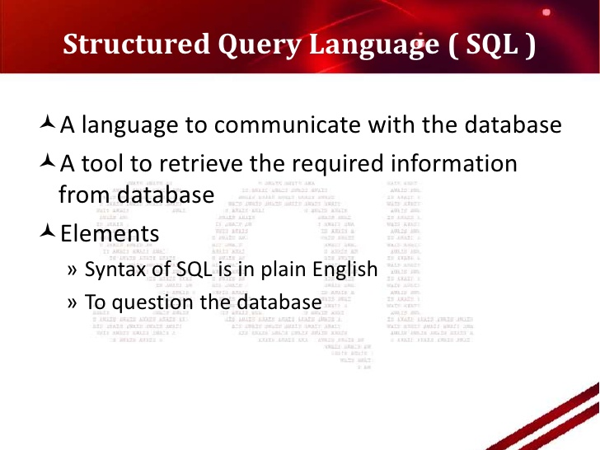
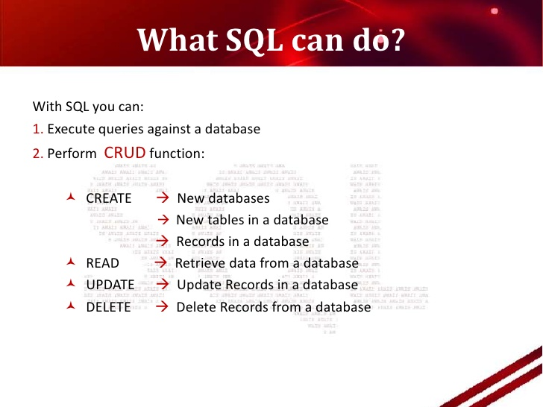
Introduction to SQL

Slide 6
Introduction to SQL
The name SQL is presently expanded as Structured Query Language( called SEQUEL (Structured English QUEry Language), designed and implemented at IBM Research as the interface for an experimental relational database system called SYSTEM R.
SQL is now the standard language for commercial relational DBMSs. A joint effort by the American National Standards Institute (ANSI) and the International Standards Organization (ISO) has led to a standard version of SQL (ANSI 1986), called SQL-86 or SQL1.
A revised and much expanded standard called SQL-92 (also referred to as SQL2) was subsequently developed.
Ref: http://www.contrib.andrew.cmu.edu/~shadow/sql/sql1992.txt
The next standard that is well-recognized is SQL:1999, which started out as SQL3.
Two later updates to the standard are SQL:2003 and SQL:2006, which added XML features among other updates to the language.
Another update in 2008 incorporated more object database features in SQL .
The latest version is SQL:2016 supports JSON , row pattern recognition, more trigonometric and log functions…
Note : https://www.whoishostingthis.com/resources/ansi-sql-standards/
SQL Standard docs: https://standards.iso.org/ittf/PubliclyAvailableStandards/index.html

Slide 7
Different commercial SQL versions
MySQL, Oracle, MS SQL server are enterprise editions.
SQL Lite is a light weight , file-based database and database migration is easy.
Some have their own SQL versions comply with SQL standard version of ANSI
SQL (ANSI standard international) standard SQL.
T-SQL (Microsoft product) Transact SQL – used in MS SQL server
Extends the basic standard SQL with more features.
PL-SQL (Oracle Product) Procedural SQL – used in Oracle
Extended version of standard SQL.
SQL *plus (Oracle product) used in ORACLE
(SQL*Plus is a client terminal software allowing users to interact with Oracle server to manipulate data and data structures.)
PostgreSQL ---- open source RDBMS supporting basic standard SQL on OORDBMS + support for JSON feature.

Slide 8
More info….
ANSI SQL is a specification, not a particular product. It's a document, describing the official features of the SQL language. Every brand of SQL RDBMS implements a subset of ANSI SQL. Every brand of SQL RDBMS adds some features to the language that are not in the ANSI SQL specification probably they tweak ANSI SQL syntax as well.
And each brand implements features in its own way, not necessarily compatible with the others.
Ref: https://www.guru99.com/oracle-vs-sql-server.html
https://www.digitalocean.com/community/tutorials/sqlite-vs-mysql-vs-postgresql-a-comparison-of-relational-database-management-systems

Slide 9
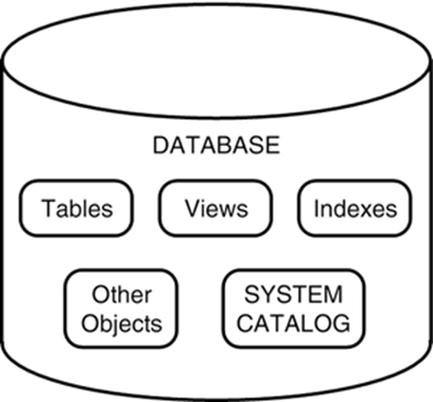
Schema and Catalog Concepts in SQL
DATABASE and SCHEMA are same.

Slide 10
SQL statements
Data Definition Language (DDL) statements are used to define the database structure or schema.
Some examples:
CREATE - to create objects in the database
ALTER - alters the structure of the database
DROP - delete objects from the database
TRUNCATE - remove all records from a table, including all spaces allocated for the records are removed
COMMENT - add comments to the data dictionary
RENAME - rename an object

Slide 11
SQL statements
Data Manipulation Language (DML) statements are used for managing data within schema objects.
Some examples:
SELECT - retrieve data from the a database
INSERT - insert data into a table
UPDATE - updates existing data within a table
DELETE - deletes all records from a table, the space for the records remain
MERGE - UPSERT operation (insert or update)
CALL - call a PL/SQL or Java subprogram
EXPLAIN PLAN - explain access path to data
LOCK TABLE - control concurrency

Slide 12
SQL statements
Data Control Language (DCL) statements.
Some examples:
GRANT - gives user's access privileges to database
REVOKE - withdraw access privileges given with the GRANT command
Transaction Control (TCL) statements are used to manage the changes made by DML statements. It allows statements to be grouped together into logical transactions.
COMMIT - save work done
SAVEPOINT - identify a point in a transaction to which you can later roll back
ROLLBACK - restore database to original since the last COMMIT
SET TRANSACTION - Change transaction options like isolation level and what rollback segment to use

Slide 13
DATA TYPES

Slide 14
DATA TYPES
Data type | Description
INTEGER(p) | Integer numerical (no decimal). Precision p
SMALLINT | Integer numerical (no decimal). Precision 5
INTEGER | Integer numerical (no decimal). Precision 10
BIGINT | Integer numerical (no decimal). Precision 19
DECIMAL(p,s) | Exact numerical, precision p, scale s. Example: decimal(5,2) is a number that has 3 digits before the decimal and 2 digits after the decimal
NUMERIC(p,s) | Exact numerical, precision p, scale s. (Same as DECIMAL)
FLOAT(p) | Approximate numerical, mantissa precision p. A floating number in base 10 exponential notation. The size argument for this type consists of a single number specifying the minimum precision
REAL | Approximate numerical, mantissa precision 7
FLOAT | Approximate numerical, mantissa precision 16
DOUBLE PRECISION | Approximate numerical, mantissa precision 16
Notes:
integer numbers of various sizes (INTEGER or
INT, and SMALLINT) and floating-point (real) numbers of various precision
(FLOAT or REAL, and DOUBLE PRECISION).
Boolean data type has the traditional values of TRUE or FALSE. In SQL,
because of the presence of NULL values, a three-valued logic is used, so a
third possible value for a Boolean data type is UNKNOWN.
value ‘Smith’ is for an attribute of type CHAR(10), it is padded with five blank characters to become ‘Smith ’

Slide 15
DATA TYPES
Data type | Description
CHARACTER(n) | Character string. Fixed-length n
VARCHAR(n) or CHARACTER VARYING(n) | Character string. Variable length. Maximum length n
BINARY(n) | Binary string. Fixed-length n
BOOLEAN | Stores TRUE or FALSE values
VARBINARY(n) or BINARY VARYING(n) | Binary string. Variable length. Maximum length n
INTEGER(p) | Integer numerical (no decimal). Precision p
SMALLINT | Integer numerical (no decimal). Precision 5
INTEGER | Integer numerical (no decimal). Precision 10
Notes:
integer numbers of various sizes (INTEGER or
INT, and SMALLINT) and floating-point (real) numbers of various precision
(FLOAT or REAL, and DOUBLE PRECISION).
Boolean data type has the traditional values of TRUE or FALSE. In SQL,
because of the presence of NULL values, a three-valued logic is used, so a
third possible value for a Boolean data type is UNKNOWN.
value ‘Smith’ is for an attribute of type CHAR(10), it is padded with five blank characters to become ‘Smith ’

Slide 16
DATA TYPES
Numeric data types
• Integer numbers: INTEGER, INT, and SMALLINT
• Floating-point (real) numbers: FLOAT or REAL, and DOUBLE PRECISION
• format is DECIMAL(i,j) or DEC(i,j) or NUMERIC(i,j) where i is the total number of decimal digits (the precision) and j is the number of digits after the decimal point (the scale)
• The default for scale is zero, and the default for precision is implementation-defined
Character-string data types
• Fixed length: CHAR(n), CHARACTER(n)
• A shorter string is padded with blank characters to the right
• Varying length: VARCHAR(n), CHAR VARYING(n), CHARACTER VARYING(n)where n is the maximum number of characters
• The literal string value is placed between single quotation and is case sensitive. E.g., ‘yourString’
• Concatenation operator denoted by || that can concatenate two string
E.g., ‘abc’||’XYZ’ results in a single string ‘abcXYZ’
• Large text values, such as document: CHARACTER LARGE OBJECT or CLOB
eg., CLOB (20M)
Notes:
DECIMAL(i,j)—or DEC(i,j) or NUMERIC(i,j)—where i, the
precision, is the total number of decimal digits and j, the scale, is the number
of digits after the decimal point.
DATE data type has ten positions, and its components are YEAR, MONTH, and DAY in the form YYYY-MM-DD.
TIME data type has at least eight positions, with the components HOUR, MINUTE, and SECOND in the form HH:MM:SS.

Slide 17
DATA TYPES
Variable-length string data type called CHARACTER LARGE OBJECT or
CLOB is also available to specify columns that have large text values, such
as documents.
The CLOB maximum length can be specified in kilobytes (K), megabytes (M),
or gigabytes (G). For example, CLOB(20M) specifies a maximum length of
20 megabytes.
variable-length bitstring data type called BINARY LARGE OBJECT or BLOB is also available to specify columns that have large binary values, such as images.
maximum length of a BLOB can be specified in kilobits (K), megabits (M), or gigabits (G).
For example, BLOB(30G) specifies a maximum length of 30 gigabits.

Slide 18
DATA TYPES
INTERVAL | Composed of a number of integer fields, representing a period of time, depending on the type of interval
ARRAY | A set-length and ordered collection of elements
MULTISET | A variable-length and unordered collection of elements
XML | Stores XML data
DATE | Stores year, month, and day values
TIME | Stores hour, minute, and second values

Slide 19
DATA TYPES
DATE data type
• Ten positions
• Components are YEAR, MONTH, and DAY in the form YYYYMMDD
TIME:
• Made up of hour:minute:second in the format hh:mm:ss
• TIME(i): time fractional seconds precision, Made up of hour:minute:second plus i additional digits
specifying fractions of a second format is hh:mm:ss:ii...i
• TIME WITH TIME ZONE:
includes an additional six positions for specifying the displacement from the standard universal time zone which is zone, in the range +13:00 ---- -12:59

Slide 20
DATA TYPES
TIMESTAMP -> Stores year, month, day, hour, minute, and second values
timestamp data type (TIMESTAMP) includes the DATE and TIME fields,
plus a minimum of six positions for decimal fractions of seconds and an
optional WITH TIME ZONE qualifier.
example, TIMESTAMP ‘2008-09-27 09:12:47.648302’.
interval—a relative value that can be used to
increment or decrement an absolute value of a date, time, or timestamp.
Intervals are qualified to be either YEAR/MONTH intervals or DAY/TIME
intervals.

Slide 21
DATABASE

Slide 22
Database and SQL in MS SQL SERVER
Create a database
CREATE DATABASE database_name;
E.g., CREATE DATABASE TestDb;
Statement lists all databases
SELECT name FROM master.sys.databases ORDER BY name;
Or execute the stored procedure sp_databases
EXEC sp_databases;
Statement allows you to delete one or more databases
DROP DATABASE [ IF EXISTS ]
database_name
[,database_name2,...];
E.g., DROP DATABASE IF EXISTS TestDb;
To use a database
USE database_name;
E.g., USE testOb;

Slide 23
Database and SQL in MySQL
Create a database
CREATE DATABASE [IF NOT EXISTS] database_name
E.g., CREATE DATABASE TestDb;
Statement lists all databases
SHOW DATABASES;
Statement allows you to delete one or more databases
DROP DATABASE [ IF EXISTS ]
database_name
[,database_name2,...];
E.g., DROP DATABASE IF EXISTS TestDb;
To use a database
USE database_name;
E.g., USE testOb;

Slide 24
TABLES

Slide 25
Tables and Standard SQL
CREATE TABLE table_name(
column1 datatype,
column2 datatype,
column3 datatype,
.....
columnN datatype,
PRIMARY KEY( one or more columns )
);
DROP TABLE table_name;
ALTER TABLE table_name
{ADD|DROP|MODIFY} column_name {data_type};
ALTER TABLE table_name RENAME T0 table_name;

Slide 26
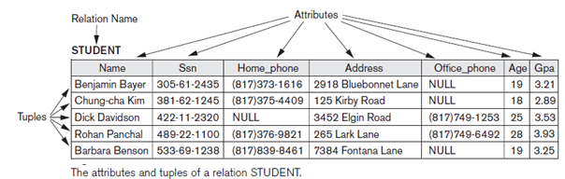
Relational model and Tables basics
Value and NULL
A column or attribute can have a valid value or with NULL value. NULL value is not white space.
Relation Key
A relation key is an attribute which can uniquely identify a particular tuple(row) in a relation(table).
Example:To locate a particular row its easy to search or go by Ssn attribute as its UNIQUE.
UNIQUE: means every person has a different Ssn.
Constraints
Constraints are conditions that must hold on all valid relation instances. There are three main types of constraints:
Key and domain constraints
Entity integrity constraints
Referential integrity constraints

Slide 27
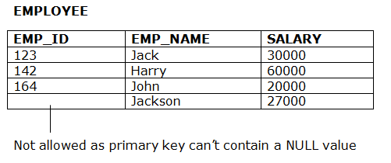
Relational model and Tables basics
Constraints:
Key constraints: specifies that there should be such an attribute(column) in a relation(table), which can be used to fetch data for any tuple(row). The Key attribute should never be same for two /more different rows of data.
Example: SSN value should not be repeated ie., should be UNIQUE.
Domain Constraint: refers to the rules defined for the values that can be stored for a certain attribute.
Example: Age cannot have negative values.
Entity Integrity constraint: A primary key column should not have NULL values.
see figure below:

Slide 28
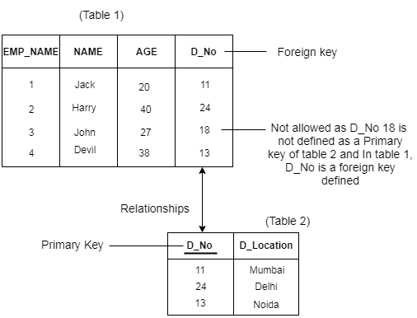
Relational model and Tables basics
Constraints:
Referential Integrity constraints:
A referential integrity constraint is specified between two tables.
In the Referential integrity constraints, if a foreign key in Table 1 refers to the Primary Key of Table 2, then every value of the Foreign Key in Table 1 must be null or be available in Table 2. Shown in fig 3.3 below.
RI in short is no orphaned children allowed.

Slide 29
Tables and Standard SQL
CREATE
CREATE TABLE (db.table_name or table_name) ( column_name1 data_type(size), column_name2 data_type(size), column_name3 data_type(size), .... );
SQL CREATE TABLE + CONSTRAINT Syntax
CREATE TABLE table_name ( column_name1 data_type(size) constraint_name, column_name2 data_type(size) constraint_name, column_name3 data_type(size) constraint_name, .... );
SQL, we have the following constraints:
NOT NULL - Ensures that a column cannot have a NULL value
UNIQUE - Ensures that all values in a column are different
PRIMARY KEY - A combination of a NOT NULL and UNIQUE. Uniquely identifies each row in a table
FOREIGN KEY - Uniquely identifies a row/record in another table
CHECK - Ensures that all values in a column satisfies a specific condition
DEFAULT - Sets a default value for a column when no value is specified
INDEX - Used to create and retrieve data from the database very quickly

Slide 30
SQL Statement – CREATE
NOT NULL
CREATE TABLE Persons ( PersonID int, LastName varchar(255), FirstName varchar(255), Address varchar(255), City varchar(255) );
The NOT NULL constraint enforces a column to NOT accept NULL values.
The NOT NULL constraint enforces a field to always contain a value. This means that you cannot insert a new record, or update a record without adding a value to this field.
The following SQL enforces the "P_Id" column and the "LastName" column to not accept NULL values:
CREATE TABLE suppliers (
supplier_id int NOT NULL,
supplier_name char(50) NOT NULL,
contact_name char(50) );

Slide 31
SQL PRIMARY KEY Constraint
The PRIMARY KEY constraint uniquely identifies each record in a database table.
Primary keys must contain UNIQUE values.
A primary key column cannot contain NULL values.
Most tables should have a primary key, and each table can have only ONE primary key.
Eg., Creates a PRIMARY KEY on the "P_Id" column (one column only ) when the "Persons" table is created:
CREATE TABLE Persons ( P_Id int NOT NULL, LastName varchar(255) NOT NULL, FirstName varchar(255), Address varchar(255), City varchar(255), CONSTRAINT pk_PersonID PRIMARY KEY (P_Id,LastName) );

Slide 32
SQL PRIMARY KEY Constraint
To allow naming of a PRIMARY KEY constraint, and for defining a PRIMARY KEY constraint on multiple columns, use the following SQL syntax:
CREATE TABLE Persons ( P_Id int NOT NULL, LastName varchar(255) NOT NULL, FirstName varchar(255), Address varchar(255), City varchar(255), CONSTRAINT pk_PersonID PRIMARY KEY (P_Id,LastName) )
Though there is only ONE PRIMARY KEY (pk_PersonID). However, the VALUE of the primary key is made up of TWO COLUMNS (P_Id + LastName).

Slide 33
SQL FOREIGN KEY Constraint
A FOREIGN KEY in one table points to a PRIMARY KEY in another table.
Let's illustrate the foreign key with an example. Look at the following two tables:
The "Persons" table:
P_Id | LastName | FirstName | Address | City
1 | Hansen | Ola | Timoteivn 10 | Sandnes
2 | Svendson | Tove | Borgvn 23 | Sandnes
3 | Pettersen | Kari | Storgt 20 | Stavanger
The "Orders" table:
O_Id | OrderNo | P_Id
1 | 77895 | 3
2 | 44678 | 3
3 | 22456 | 2
4 | 24562 | 1

Slide 34
SQL FOREIGN KEY Constraint
"P_Id" column in the "Orders" table points to the "P_Id" column in the "Persons" table.
The "P_Id" column in the "Persons" table is the PRIMARY KEY in the "Persons" table.
The "P_Id" column in the "Orders" table is a FOREIGN KEY in the "Orders" table.
The FOREIGN KEY constraint is used to prevent actions that would destroy links between tables.
The FOREIGN KEY constraint also prevents invalid data from being inserted into the foreign key column, because it has to be one of the values contained in the table it points to.

Slide 35
SQL FOREIGN KEY Constraint
Eg., SQL creates a FOREIGN KEY on the "P_Id" column when the "Orders" table is created:
CREATE TABLE Orders ( O_Id int NOT NULL, OrderNo int NOT NULL, P_Id int, PRIMARY KEY (O_Id), CONSTRAINT fk_PerOrders FOREIGN KEY (P_Id) REFERENCES Persons(P_Id) )

Slide 36
SQL FOREIGN KEY Constraint
FOREIGN KEY clause
Default operation: reject update on violation
Attach referential triggered action clause
• Options include SET NULL, CASCADE, and SET DEFAULT
• Action taken by the DBMS for SET NULL or SET DEFAULT is the same
for both ON DELETE and ON UPDATE
• CASCADE option suitable for “relationship” relations, for relations that
represent multivalued attributes, and for relations that represent weak
entity types

Slide 37

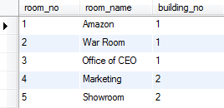
SQL FOREIGN KEY Constraint
CREATE TABLE buildings (
building_no int(11) NOT NULL AUTO_INCREMENT,
building_name varchar(255) NOT NULL,
address varchar(355) NOT NULL,
PRIMARY KEY (building_no)
) ;
CREATE TABLE rooms (
room_no int(11) NOT NULL AUTO_INCREMENT,
room_name varchar(255) NOT NULL,
building_no int(11) NOT NULL,
PRIMARY KEY (room_no),
KEY building_no (building_no),
CONSTRAINT rooms_ibfk_1
FOREIGN KEY (building_no)
REFERENCES buildings (building_no)
ON DELETE CASCADE
)

Slide 38

SQL FOREIGN KEY Constraint
DELETE FROM buildings WHERE building_no = 2

Slide 39
SQL FOREIGN KEY Constraint
Eg., cascading referential actions can be based on the
create table Products (
:
CONSTRAINT FK_Products_Suppliers FOREIGN KEY (SupplierID) REFERENCES Suppliers(SupplierID) ON DELETE SET DEFAULT ON UPDATE CASCADE);
);
If ON DELETE CASCADE is specified for the constraint, deleting the row in Suppliers where SupplierID equals 1 also deletes the three rows in Products where SupplierID equals 1.
If ON UPDATE CASCADE is specified for the constraint, updating the SupplierID value in the Suppliers table from 1 through 55 also updates the SupplierID values in the three rows in Products whose SupplierID values currently equal 1.

Slide 40
What is a foreign key with Cascade DELETE in SQL ?
A foreign key with cascade delete means that if a record in the parent table is deleted, then the corresponding records in the child table will automatically be deleted. This is called a cascade delete in SQL Server.
A foreign key with cascade delete can be created using either a CREATE TABLE statement or an ALTER TABLE statement.
CREATE TABLE child_table (
column1 datatype [ NULL | NOT NULL ],
column2 datatype [ NULL | NOT NULL ], ...
CONSTRAINT fk_name FOREIGN KEY (child_col1, child_col2, ... child_col_n)
REFERENCES parent_table (parent_col1, parent_col2, ... parent_col_n)
ON DELETE CASCADE [ ON UPDATE { NO ACTION | CASCADE | SET NULL | SET DEFAULT } ] );

Slide 41
What is a foreign key with Cascade DELETE in SQL ?
child_table
The name of the child table that you wish to create.
column1, column2
The columns that you wish to create in the table. Each column must have a datatype.
The column should either be defined as NULL or NOT NULL and if this value is left blank, the database
assumes NULL as the default.
fk_name
The name of the foreign key constraint that you wish to create.
child_col1, child_col2, ... child_col_n
The columns in child_table that will reference a primary key in the parent_table.
parent_table
The name of the parent table whose primary key will be used in the child_table.
parent_col1, parent_col2, ... parent_col3
The columns that make up the primary key in the parent_table. The foreign key will enforce a link between
this data and the child_col1, child_col2, ... child_col_n columns in the child_table.
ON DELETE CASCADE
It specifies that the child data is deleted when the parent data is deleted.

Slide 42
What is a foreign key with Cascade DELETE in SQL ?
ON UPDATE
Optional. It specifies what to do with the child data when the parent data is updated. You have the options : of NO ACTION, CASCADE, SET NULL, or SET DEFAULT.
NO ACTION
It is used in conjunction with ON DELETE or ON UPDATE. It means that no action is performed with the child data when the parent data is deleted or updated.
CASCADE
It is used in conjunction with ON DELETE or ON UPDATE. It means that the child data is either deleted or updated when the parent data is deleted or updated.
SET NULL
It is used in conjunction with ON DELETE or ON UPDATE. It means that the child data is set to NULL when the parent data is deleted or updated.
SET DEFAULT
It is used in conjunction with ON DELETE or ON UPDATE. It means that the child data is set to their default values when the parent data is deleted or updated.

Slide 43
foreign key with Cascade DELETE in SQL
Example
CREATE TABLE products (
product_id INT PRIMARY KEY,
product_name VARCHAR(50) NOT NULL,
category VARCHAR(25) );
CREATE TABLE inventory (
inventory_id INT PRIMARY KEY,
product_id INT NOT NULL,
quantity INT,
min_level INT,
max_level INT,
CONSTRAINT fk_inv_product_id FOREIGN KEY (product_id)
REFERENCES products (product_id) ON DELETE CASCADE );
Notes:
In this foreign key example, we've created our parent table as the products table. The products table has a primary key that consists of the product_id field.
Next, we've created a second table called inventory that will be the child table in this foreign key with cascade delete example. We have used the CREATE TABLE statement to create a foreign key on the inventory table called fk_inv_product_id. The foreign key establishes a relationship between the product_id column in the inventory table and the product_id column in the products table.
For this foreign key, we have specified the ON DELETE CASCADE clause which tells SQL Server to delete the corresponding records in the child table when the data in the parent table is deleted. So in this example, if a product_id value is deleted from the products table, the corresponding records in the inventory table that use this product_id will also be deleted.

Slide 44
SQL FOREIGN KEY Constraint
Specification | Update operation on parent table | Delete operation on parent table
No Action | Not allowed. Error message would be generated. | Not allowed. Error message would be generated.
Cascade | Associated values in child table would also be updated. | Associated records in child table would also be deleted.
Set NULL | Associated values in child table would be set to NULL. Foreign key column should allow NULL values to specify this rule. | Associated values in child table would be set to NULL. Foreign key column should allow NULL values to specify this rule.
Set Default | Associated values in child table would be set to default value specified in column definition. Also default value should be present in primary key column. Otherwise basic requirement of FK relation would fail and update operation would not be successful. If no default value is provided in foreign key column this rule could not be implemented. | Associated values in child table would be set to default value specified in column definition. Also default value should be present in primary key column. Otherwise basic requirement of FK relation would fail and delete operation would not be successful. If no default value is provided in foreign key column this rule could not be implemented.

Slide 45
SQL UNIQUE Constraint
The UNIQUE constraint uniquely identifies each record in a database table.
The UNIQUE and PRIMARY KEY constraints both provide a guarantee for uniqueness for a column or set of columns.
A PRIMARY KEY constraint automatically has a UNIQUE constraint defined on it.
Note that you can have many UNIQUE constraints per table, but only one PRIMARY KEY constraint per table.
Eg., SQL creates a UNIQUE constraint on the "P_Id" column when the "Persons" table is created:
CREATE TABLE Persons ( P_Id int NOT NULL UNIQUE, LastName varchar(255) NOT NULL, FirstName varchar(255), Address varchar(255), City varchar(255) )

Slide 46
SQL UNIQUE Constraint
To allow naming of a UNIQUE constraint, and for defining a UNIQUE constraint on multiple columns, use the following SQL syntax:
CREATE TABLE Persons ( P_Id int NOT NULL, LastName varchar(255) NOT NULL, FirstName varchar(255), Address varchar(255), City varchar(255), CONSTRAINT uc_PersonID UNIQUE (P_Id,LastName) )

Slide 47
SQL CHECK Constraint
The CHECK constraint is used to limit the value range that can be placed in a column.
If you define a CHECK constraint on a single column it allows only certain values for this column.
If you define a CHECK constraint on a table it can limit the values in certain columns based on values in other columns in the row.
CHECK constraint on the "P_Id" column when the "Persons" table is created. The CHECK constraint specifies that the column "P_Id" must only include integers greater than 0.
CREATE TABLE Persons ( P_Id int NOT NULL, LastName varchar(255) NOT NULL, FirstName varchar(255), Address varchar(255), City varchar(255), CHECK (P_Id>0) )
CREATE TABLE Persons ( P_Id int NOT NULL CHECK (P_Id>0), LastName varchar(255) NOT NULL, FirstName varchar(255), Address varchar(255), City varchar(255) )

Slide 48
SQL CHECK Constraint
To allow naming of a CHECK constraint, and for defining a CHECK constraint on multiple columns, use the following SQL syntax:
CREATE TABLE Persons ( P_Id int NOT NULL, LastName varchar(255) NOT NULL, FirstName varchar(255), Address varchar(255), City varchar(255), CONSTRAINT chk_Person CHECK (P_Id>0 AND City='Sandnes') )

Slide 49
SQL DEFAULT Constraint
The DEFAULT constraint is used to insert a default value into a column.
The default value will be added to all new records, if no other value is specified.
eg., Creates a DEFAULT constraint on the "City" column when the "Persons" table is created
CREATE TABLE Persons ( P_Id int NOT NULL, LastName varchar(255) NOT NULL, FirstName varchar(255), Address varchar(255), City varchar(255) DEFAULT 'Sandnes' )
Dno INT NOT NULL DEFAULT 1,

Slide 50
ALTER /Delete /drop table
Drop a table:
DROP TABLE table_name;
Get the table structure:
DESC table_name;
Modify the table structure:
ALTER TABLE table_name {ADD|DROP|MODIFY} column_name {data_ype};
Rename the table:
ALTER TABLE table_name RENAME TO new_table_name;
remove all records from a table
But table structure remains.
TRUNCATE TABLE table_name;
Or Delete * from table_name;
DROP TABLE Shippers;
DESC Shippers;
ALTER TABLE Customers ADD Email varchar(255);
ALTER TABLE Customers DROP COLUMN Email;
ALTER TABLE Persons ALTER COLUMN DateOfBirth year;
TRUNCATE TABLE Categories;

Slide 51
Tables and MySQL
Create a table syntax:
CREATE TABLE [IF NOT EXISTS] table_name(
column_1_definition,
column_2_definition,
...,
table_constraints
) ;
To see the table structure
DESCRIBE table_name;
eg.,
CREATE TABLE IF NOT EXISTS tasks (
task_id INT AUTO_INCREMENT PRIMARY KEY,
title VARCHAR(255) NOT NULL,
start_date DATE,
due_date DATE,
status TINYINT NOT NULL,
priority TINYINT NOT NULL,
description TEXT,
created_at TIMESTAMP DEFAULT CURRENT_TIMESTAMP
);
Eg.,
DESCRIBE tasks;

Slide 52
Tables and MySQL
To copy data from a table to a new table, you use CREATE TABLE and SELECT statements as follows:
CREATE TABLE new_table
SELECT col, col2, col3
FROM
existing_table;
Or
CREATE TABLE new_table
SELECT col, col2, col3
FROM
existing_table
Where condition;
CREATE TABLE with a foreign key primary key example:
CREATE TABLE IF NOT EXISTS checklists (
todo_id INT AUTO_INCREMENT,
task_id INT,
todo VARCHAR(255) NOT NULL,
is_completed BOOLEAN NOT NULL DEFAULT FALSE,
PRIMARY KEY (todo_id , task_id),
FOREIGN KEY (task_id)
REFERENCES tasks (task_id)
ON UPDATE RESTRICT ON DELETE CASCADE
);
E.g.,
CREATE TABLE IF NOT EXISTS offices_usa
SELECT * FROM offices;
E.g.
CREATE TABLE IF NOT EXISTS offices_usa
SELECT * FROM offices WHERE
country = 'USA’;

Slide 53
Tables and MySQL
Autoincrement:
primary key field that we would like to be created automatically every time a new record is inserted.
AUTO_INCREMENT keyword to perform an auto-increment feature.
By default, the starting value for AUTO_INCREMENT is 1, and it will increment by 1 for each new record.
To let the AUTO_INCREMENT sequence start with another value
CREATE TABLE Persons ( Personid int NOT NULL AUTO_INCREMENT, LastName varchar(255) NOT NULL, FirstName varchar(255), Age int, PRIMARY KEY (Personid) );
Eg.,
ALTER TABLE Persons AUTO_INCREMENT=100;

Slide 54
Tables and MySQL
Add a column to a table
ALTER TABLE table_name
ADD new_column_name column_definition
[FIRST | AFTER column_name]
Add multiple columns to a table
ALTER TABLE table_name
ADD new_column_name column_definition
[FIRST | AFTER column_name],
ADD new_column_name column_definition
[FIRST | AFTER column_name],
...;
Modify a column
ALTER TABLE table_name
MODIFY column_name column_definition
[ FIRST | AFTER column_name];
Modify multiple columns
ALTER TABLE table_name
MODIFY column_name column_definition
[ FIRST | AFTER column_name],
MODIFY column_name column_definition
[ FIRST | AFTER column_name],
...;
eg.,
ALTER TABLE vehicles
ADD model VARCHAR(100) NOT NULL;
Eg.,
ALTER TABLE vehicles
ADD color VARCHAR(50),
ADD note VARCHAR(255);
Eg.,
ALTER TABLE vehicles
MODIFY note VARCHAR(100) NOT NULL;
Eg.,
ALTER TABLE vehicles
MODIFY year SMALLINT NOT NULL,
MODIFY color VARCHAR(20) NULL AFTER make;

Slide 55
Tables and MySQL
To delete a column from table:
ALTER TABLE table_name DROP COLUMN column_name;
Eg.,
ALTER TABLE Customers DROP COLUMN Email;
To delete a table from database:
DROP TABLE table_name;
Eg.,
DROP TABLE persons;
To see all the tables in the current database:
SHOW tables;

Slide 56
Tables and MS SQL server
Create a table syntax:
CREATE TABLE [database_name.][schema_name.]table_name (
pk_column data_type PRIMARY KEY,
column_1 data_type NOT NULL,
column_2 data_type,
...,
table_constraints
);
To see the table structure
DESCRIBE table_name;
eg.,
CREATE TABLE sales.visits (
visit_id INT PRIMARY KEY IDENTITY (1, 1),
first_name VARCHAR (50) NOT NULL,
last_name VARCHAR (50) NOT NULL,
visited_at DATETIME,
phone VARCHAR(20),
store_id INT NOT NULL,
FOREIGN KEY (store_id) REFERENCES sales.stores (store_id)
);
Eg.,
DESCRIBE tasks;

Slide 57
Tables and MS SQL server
Schema is a collection of database objects including tables, views, triggers, stored procedures, indexes, etc.
A schema is associated with a username which is known as the schema owner.
A schema always belongs to one database. On the other hand, a database may have one or multiple schemas.
Two tables in two schemas can share the same name so you may have
e.g.,
hr.employee and sales.employee
where employee is the table in both
schemas.
Built-in schemas in SQL Server like:
dbo, guest, sys, and INFORMATION_SCHEMA
to delete a schema from a database.
DROP SCHEMA [IF EXISTS] schema_name;
The schema should be emtpty to drop schema else it throws error.
CREATE SCHEMA schema_name
[AUTHORIZATION owner_name]
E.g.,
CREATE SCHEMA customer_services;
GO
GO command instructs the SQL Server Management Studio to send the SQL statements up to the GO statement to the server to be executed.
E.g.,
DROP SCHEMA logistics;

Slide 58
Tables and MS SQL server
The ALTER SCHEMA statement allows you to transfer a securable from a schema to another within the same database.
ALTER SCHEMA target_schema_name
TRANSFER [ entity_type :: ] securable_name;
1.CREATE TABLE dbo.offices
(
office_id INT
PRIMARY KEY IDENTITY,
office_name NVARCHAR(40) NOT NULL,
office_address NVARCHAR(255) NOT NULL,
phone VARCHAR(20),
);
2.Next, insert some rows into the dob.offices table:
3. After that, transfer this dbo.offices table to the sales schema:
ALTER SCHEMA sales TRANSFER OBJECT::dbo.offices;
4. if you access it as dbo.offices it gives error!!
SELECT * FROM dbo.offices WHERE office_id = @id;
After having the customer_services schema, you can create objects for the schema. For example, the following statement creates a new table named jobs in the customer_services schema:
CREATE TABLE customer_services. jobs(
job_id INT PRIMARY KEY IDENTITY,
customer_id INT NOT NULL,
description VARCHAR(200),
created_at DATETIME2 NOT NULL
);

Slide 59
Tables and MSSQL Server
Autoincrement:
primary key field that we would like to be created automatically every time a new record is inserted.
MS SQL Server uses the IDENTITY keyword to perform an auto-increment feature.
In the example above, the starting value for IDENTITY is 1, and it will increment by 1 for each new record.
Tip: To specify that the "Personid" column should start at value 10 and increment by 5, change it to IDENTITY(10,5).
CREATE TABLE Persons ( Personid int IDENTITY(1,1) PRIMARY KEY, LastName varchar(255) NOT NULL, FirstName varchar(255), Age int );
Eg.,
ALTER TABLE Persons AUTO_INCREMENT=100;

Slide 60
Tables and MSSQL Server
Add a column to a table
ALTER TABLE table_name
ADD new_column_name column_definition
[FIRST | AFTER column_name]
Add multiple columns to a table
ALTER TABLE table_name
ADD
column_name_1 data_type_1 column_constraint_1,
column_name_2 data_type_2 column_constraint_2,
...,
column_name_n data_type_n column_constraint_n;
...;
Modify a column
ALTER TABLE table_name
ALTER COLUMN column_name new_data_type(size);
Modify multiple columns
SQL Server T-SQL doesn't allow multiple columns to be changed in one ALTER TABLE command (unlike some other languages where it's possible).
Alter each column separately in Alter statement
eg.,
ALTER TABLE vehicles
ADD model VARCHAR(100) NOT NULL;
Eg.,
ALTER TABLE vehicles
ADD color VARCHAR(50),
note VARCHAR(255);
Eg.,
ALTER TABLE t1 ALTER COLUMN c VARCHAR (2);
Eg.,
ALTER TABLE vehicles
Alter year SMALLINT NOT NULL;
ALTER TABLE vehicls
MODIFY color VARCHAR(20) NULL AFTER make;

Slide 61
Tables and MSSQL Server
To delete a column from table:
ALTER TABLE table_name DROP COLUMN column_name;
Eg.,
ALTER TABLE Customers DROP COLUMN Email;
To delete a table from database:
DROP TABLE table_name;
Eg.,
DROP TABLE persons;
To delete multiple columns at once, you use the following syntax:
ALTER TABLE table_name
DROP COLUMN column_name_1, column_name_2,...;
Eg.,
ALTER TABLE sales.price_lists
DROP COLUMN discount, surcharge;

Slide 62
TABLES in MSSQL Server
To delete all rows from a table :
TRUNCATE TABLE table_name;
E.g.,
TRUNCATE TABLE sales.addresses;
To delete a table from database:
DROP TABLE [IF EXISTS] [database_name.][schema_name.]table_name;
Eg.,
DROP TABLE IF EXISTS sales.revenues;
To remove multiple tables at once using a single
DROP TABLE statement as follows:
DROP TABLE
[database_name.][schema_name.]table_name_1,
[database_name.][schema_name.]table_name_2,
...
[database_name.][schema_name.]table_name_n;

Slide 63
TABLES in MSSQL Server
SQL Server does not allow you to delete a table that is referenced by a foreign constraint. To delete this table, you must drop the referencing foreign key constraint or referencing table first. In this case, you have to drop delete the foreign key constraint in the suppliers table or the suppliers table first before removing the supplier_groups table.
DROP TABLE procurement.supplier_groups;
DROP TABLE procurement.suppliers;
a single DROP TABLE statement to remove both tables, the referencing table must be listed first as shown in the query below:
DROP TABLE procurement.suppliers, procurement.supplier_groups;;

Slide 64
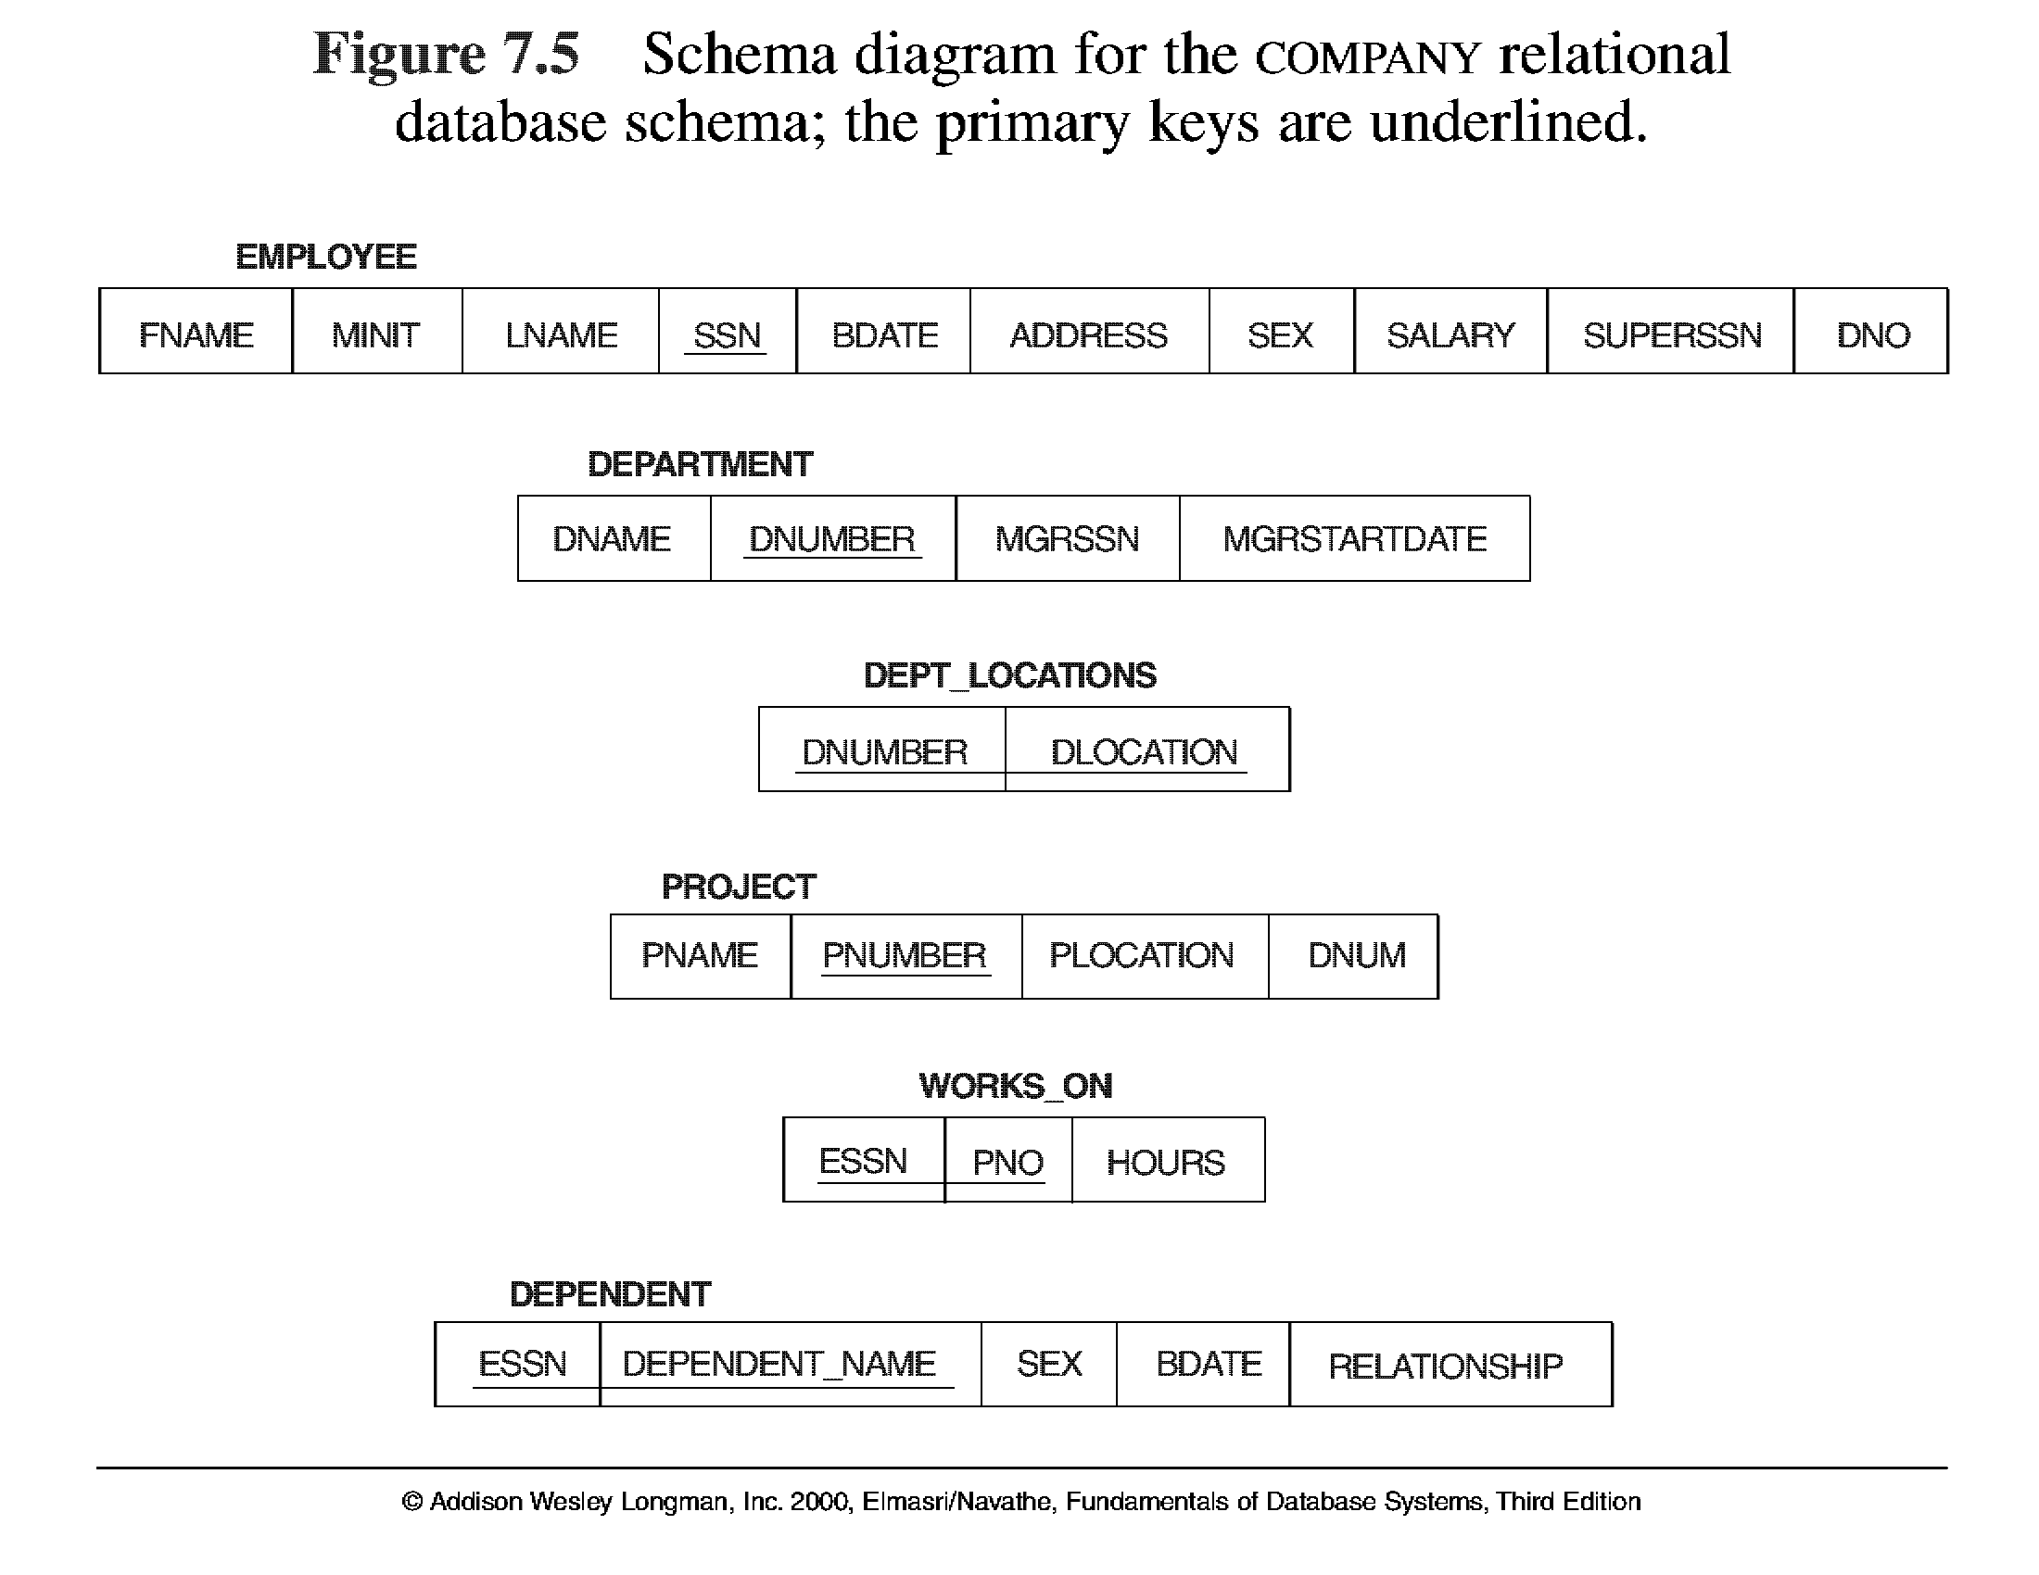
CREATE TABLE Command in SQL

Slide 65
CREATE TABLE Command in SQL
CREATE TABLE departments (
department_id int NOT NULL,
department_name char(50) NOT NULL,
CONSTRAINT departments_pk PRIMARY KEY (department_id)
);
create a SQL table called employees that stores employee number, employee name, department, and salary information. The primary key for the employees table should be the employee number. Create a foreign key on the employees table that references the departments table based on the department_id field.
CREATE TABLE employees (
employee_number int NOT NULL,
employee_name char(50) NOT NULL,
department_id int,
salary int,
CONSTRAINT employees_pk PRIMARY KEY (employee_number),
CONSTRAINT fk_departments FOREIGN KEY (department_id) REFERENCES departments(department_id)
);

Slide 66
CREATE TABLE Command in SQL
CREATE TABLE departments (
department_id int NOT NULL,
department_name char(50) NOT NULL,
CONSTRAINT departments_pk PRIMARY KEY (department_id)
);
create a SQL table called employees that stores employee number, employee name, department, and salary information. The primary key for the employees table should be the employee number. Create a foreign key on the employees table that references the departments table based on the department_id field.
CREATE TABLE employees (
employee_number int NOT NULL,
employee_name char(50) NOT NULL,
department_id int,
salary int,
CONSTRAINT employees_pk PRIMARY KEY (employee_number),
CONSTRAINT fk_departments FOREIGN KEY (department_id) REFERENCES departments(department_id)
);

Slide 67
CREATE TABLE Command in SQL

Slide 68
CREATE TABLE Command in SQL

Slide 69
CREATE TABLE Command in SQL

Slide 70
CREATE TABLE Command in SQL

Slide 71
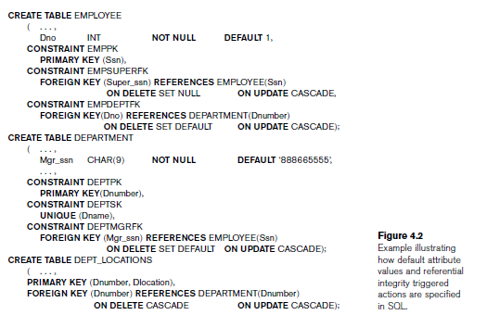
CREATE TABLE Command in SQL

Slide 72
Attribute Data Types and Domains in
SQL
Domain
Name used with the attribute specification Makes it easier to change the data type for a domain that is used by numerous attributes Improves schema readability
Example:
CREATE DOMAIN SSN_TYPE AS CHAR(9);
• A domain can also have an optional default specification via a DEFAULT clause

Slide 73
CREATE TABLE Command in SQL

Slide 74
INSERT tuples.
INSERT is used to add a single tuple to a relation.
Specify the relation name and a list of values for the tuple.
The values should be listed in the same order in which the corresponding attributes were specified in the CREATE TABLE command.
Eg., INSERT INTO EMPLOYEE
VALUES ( ‘Richard’, ‘K’, ‘Marini’, ‘653298653’, ‘1962-12-30’, ‘98Oak Forest, Katy, TX’, ‘M’, 37000, ‘653298653’, 4 );
Eg., to enter a tuple for a new EMPLOYEE for whom we know only the Fname, Lname, Dno, and Ssn attributes, we can use U1A:
INSERT INTO EMPLOYEE (Fname, Lname, Dno, Ssn) VALUES (‘Richard’, ‘Marini’, 4, ‘653298653’);
Attributes not specified in are set to their DEFAULT or to NULL,

Slide 75
SQL DML statements:
INSERT INTO Customers (CustomerName, ContactName, Address, City, PostalCode, Country) VALUES ('Cardinal', 'Tom B. Erichsen', 'Skagen 21', 'Stavanger', '4006', 'Norway');
To add a row into table :
specifies both the column names and the values to be inserted:
INSERT INTO table_name (column1, column2, column3, ...) VALUES (value1, value2, value3, ...);
Or
make sure the order of the values is in the same order as the columns in the table.
INSERT INTO table_name VALUES (value1, value2, value3, ...);
Copy all columns from one table to another table:
INSERT INTO table2 SELECT * FROM table1 WHERE condition;
Copy only some columns from one table into another table:
INSERT INTO table2 (column1, column2, column3, ...) SELECT column1, column2, column3, ... FROM table1 WHERE condition;
INSERT INTO Customers (CustomerName, City, Country) SELECT SupplierName, City, Country FROM Suppliers;
CustomerID | CustomerName | ContactName | Address | City | PostalCode | Country
SupplierID | SupplierName | ContactName | Address | City | Postal Code | Country

Slide 76
INSERT examples:
Eg., INSERT INTO EMPLOYEE (Fname, Lname, Ssn, Dno)
VALUES (‘Robert’, ‘Hatcher’, ‘980760540’, 2);
(U2 is rejected if referential integrity checking is provided by DBMS.)
Eg., INSERT INTO EMPLOYEE (Fname, Lname, Dno)
VALUES (‘Robert’, ‘Hatcher’, 5);
(U2A is rejected if NOT NULL checking is provided by DBMS.)
CREATE TABLE WORKS_ON_INFO
( Emp_name VARCHAR(15),
Proj_name VARCHAR(15),
Hours_per_week DECIMAL(3,1) );

Slide 77
INSERT in MySQL
In addition to previous Insert into and Insert into select
MySQL INSERT – Inserting multiple rows example
The following statement inserts three rows into the tasks table:
INSERT INTO tasks(title, priority)
VALUES
('My first task', 1),
('It is the second task',2),
('This is the third task of the week',3);

Slide 78


INSERT in MS SQL server
In addition to Insert into and Insert into select
MS SQL comes with Insert and return inserted values
To capture the inserted values, you use the OUTPUT clause.
For example, the following statement inserts a new row into the promotions table and returns the inserted value of the promotion_id column:
INSERT INTO sales.promotions (
promotion_name,
discount,
start_date,
expired_date
) OUTPUT inserted.promotion_id
VALUES
(
'2018 Fall Promotion',
0.15,
'20181001',
'20181101'
);
INSERT INTO sales.promotions (
promotion_name,
discount,
start_date,
expired_date
) OUTPUT inserted.promotion_id,
inserted.promotion_name,
inserted.discount,
inserted.start_date,
inserted.expired_date
VALUES
(
'2018 Winter Promotion',
0.2,
'20181201',
'20190101'
);

Slide 79
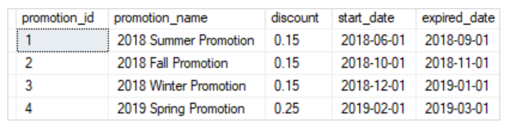
INSERT in MS SQL server
Insert explicit values into the identity column
Typically, you don’t specify a value for the identity column because SQL Server will provide the value automatically.
However, in some situations, you may want to insert a value into the identity column such as data migration.
See the following INSERT statement:
To insert explicit value for the identity column, you must execute the following statement first:
SET IDENTITY_INSERT sales.promotions ON;
INSERT INTO sales.promotions (
promotion_id,
promotion_name,
discount,
start_date,
expired_date
)
VALUES
(
4,
'2019 Spring Promotion',
0.25,
'20190201',
'20190301'
);
SET IDENTITY_INSERT sales.promotions OFF;
finally switched the identity insert off.
The output can be obtained as :
SELECT * FROM sales.promotions;

Slide 80
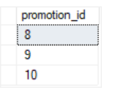
INSERT in MS SQL server
INSERT INTO sales.promotions (
promotion_name,
discount,
start_date,
expired_date
) VALUES
( '2019 Summer Promotion',
0.15,
'20190601',
'20190901'
),
( '2019 Fall Promotion',
0.20,
'20191001',
'20191101'
),
( '2019 Winter Promotion',
0.25,
'20191201',
'20200101'
);
INSERT INTO
sales.promotions (
promotion_name, discount, start_date, expired_date
)
OUTPUT inserted.promotion_id
VALUES
('2020 Summer Promotion',0.25,'20200601','20200901'),
('2020 Fall Promotion',0.10,'20201001','20201101'),
('2020 Winter Promotion', 0.25,'20201201','20210101');
To add multiple rows to a table at once, you use the following form of the INSERT statement:
INSERT INTO table_name (column_list)
VALUES
(value_list_1),
(value_list_2),
...
(value_list_n);
eg.,

Slide 81
INSERT in MS SQL server
Insert the top percent of rows
Instead of using an absolute number of rows, you can insert a percent number of rows into a table.
TRUNCATE TABLE sales.addresses;
insert top two percent of rows from the customers table sorted by first names and last names into the addresses table:
INSERT TOP (10) PERCENT
INTO sales.addresses (street, city, state, zip_code)
SELECT
street,
city,
state,
zip_code
FROM
sales.customers
ORDER BY
first_name,
last_name;
SQL Server issued the following message indicating that 145 rows have been inserted successfully.
(145 rows affected)
to insert the top 10 customers sorted by their first names and last names, you use the INSERT TOP INTO SELECT statement as follows:
TRUNCATE TABLE sales.addresses;
INSERT TOP (10)
INTO sales.addresses (street, city, state, zip_code)
SELECT
street,
city,
state,
zip_code
FROM
sales.customers
ORDER BY
first_name,
last_name;
SQL Server returned the following message showing that ten rows have been inserted successfully.
(10 rows affected)

Slide 82
DELETE Tuples
The DELETE command removes tuples from a relation. It includes a WHERE clause, similar to that used in an SQL query, to select the tuples to be deleted.
Tuples are explicitly deleted from only one table at a time. However, the deletion may propagate to tuples in other relations if referential triggered actions are specified in the referential integrity constraints of the
Depending on the number of tuples selected by the condition in the WHERE clause, zero, one, or several
tuples can be deleted by a single DELETE command.
A missing WHERE clause specifies that all tuples in the relation are to be deleted; however, the table remains in the database as an empty table.

Slide 83
DELETE examples
DELETE FROM EMPLOYEE
WHERE Lname=‘Brown’;
DELETE FROM EMPLOYEE
WHERE Ssn=‘123456789’;
DELETE FROM EMPLOYEE
WHERE Dno=5;
DELETE FROM EMPLOYEE; // deletes all employees

Slide 84
DELETE in MySQL
To delete data from a table,
DELETE FROM table_name
WHERE condition;
E.g.,
DELETE FROM employees
WHERE officeCode = 4;
To delete all rows from table:
DELETE FROM employees;
If you want to limit the number of rows to be deleted, you use the LIMIT clause as follows:
DELETE FROM table
LIMIT row_count;
DELETE FROM customers
WHERE country = 'France'
ORDER BY creditLimit
LIMIT 5;

Slide 85
DELETE in MSSQL Server
delete the 10 percent of random rows by using the following DELETE statement:
DELETE TOP 10 PERCENT FROM target_table;
eg.,
DELETE TOP (5) PERCENT FROM production.product_history;
output:
(15 rows affected)
SELEC * FROM production.product_history;
As can be seen clearly in the output, we have 321 rows in total.
To remove one or more rows from a table completely, you use the DELETE statement. The following illustrates its syntax:
DELETE [ TOP ( expression ) [ PERCENT ] ]
FROM table_name
[WHERE search_condition];
E.g.,
DELETE FROM production.product_history
WHERE model_year = 2017;
To Delete all rows:
DELETE FROM target_table;
eg.,
DELETE statement removes 10 random rows from the target_table:
DELETE TOP 10 FROM target_table;
the table stores its rows in unspecified order, we do not know which rows will be
deleted but we know for sure that the number of rows will be deleted is 10.
eg.,
DELETE TOP (21) FROM production.product_history;
output :
(21 rows affected)

Slide 86
UPDATE Tuples in SQL
The UPDATE command is used to modify attribute values of one or more selected tuples.
As in the DELETE command, a WHERE clause in the UPDATE command selects the tuples to be modified from a single relation.
primary key value may propagate to the foreign key values of tuples in other relations if such a referential triggered action is specified in the referential integrity constraints of the DDL.
An additional SET clause in the UPDATE command specifies the attributes to be modified and their new values.
to change the location and controlling department number of project number 10 to
‘Bellaire’ and 5, respectively,
UPDATE PROJECT
SET Plocation = ‘Bellaire’, Dnum = 5
WHERE Pnumber=10;
Several tuples can be modified with a single UPDATE command

Slide 87
UPDATE in SQL
UPDATE table_name
SET column1 = value1, column2 = value2, ...
WHERE condition;
eg.,
UPDATE Customers
SET ContactName = 'Alfred Schmidt', City= 'Frankfurt'
WHERE CustomerID = 1;
UPDATE Multiple Records
It is the WHERE clause that determines how many records that will be updated.
the following SQL statement will update the contactname to "Juan" for all records where country is "Mexico":
Example
UPDATE Customers
SET ContactName='Juan'
WHERE Country='Mexico';
Updates all rows in the table as there is no filter or where clause
UPDATE Customers
SET ContactName='Juan';

Slide 88
UPDATE Examples
Give all employees in the ‘Research’ department a 10 percent raise in salary
the modified Salary value depends on the original Salary value
in each tu ple, so two references to the Salary attribute are needed.
UPDATE EMPLOYEE
SET Salary = Salary * 1.1
WHERE Dno = 5;
It is also possible to specify NULL or DEFAULT as the new attribute value.
Notice that each UPDATE command explicitly refers to a single relation only.
To modify multiple relations, we must issue several UPDATE commands.

Slide 89
UPDATE in MySQL
UPDATE employees
SET
email = 'mary.patterson@classicmodelcars.com'
WHERE
employeeNumber = 1056;
Using MySQL UPDATE to modify values in multiple columns
eg.,
UPDATE employees
SET
lastname = 'Hill',
email = 'mary.hill@classicmodelcars.com'
WHERE
employeeNumber = 1056;
Using MySQL UPDATE to replace string example:
UPDATE employees
SET email = REPLACE(email,'@classicmodelcars.com','@mysqltutorial.org')
WHERE
jobTitle = 'Sales Rep' AND
officeCode = 6;
Using MySQL UPDATE to update rows returned by a SELECT statement example:
UPDATE customers
SET
salesRepEmployeeNumber = (SELECT employeeNumber
FROM employees WHERE jobtitle = 'Sales Rep'
ORDER BY RAND() LIMIT 1)
WHERE
salesRepEmployeeNumber IS NULL;

Slide 90
UPDATE in MSSQL Server
UPDATE table_name
SET c1 = v1, c2 = v2, ... cn = vn
[WHERE condition]
Update a single column in all rows example:
UPDATE sales.taxes
SET updated_at = GETDATE();
Update multiple columns example:
UPDATE sales.taxes
SET max_local_tax_rate += 0.02,
avg_local_tax_rate += 0.01
WHERE
max_local_tax_rate = 0.01;

Slide 91
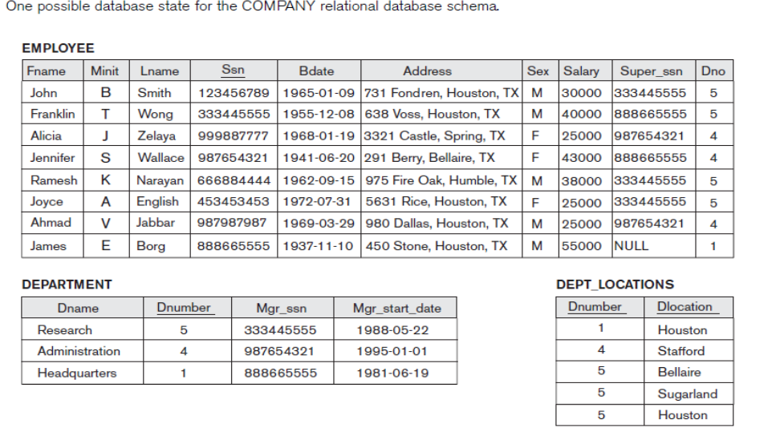
One possible database state for the COMPANY relational database schema.

Slide 92
SELECT CLAUSE in SQL
Syntax of SQL SELECT Statement:
SELECT column_list FROM table-name
[WHERE Clause]
[GROUP BY clause]
[HAVING clause]
[ORDER BY clause];
SELECT column list, function(), function(), ...
FROM table1
INNER JOIN table2
...
ON table1.col1 = table2.col2
...
WHERE criteria for row selection
[AND criteria for row selection] [OR criteria for row selection]
GROUP BY column list
HAVING criteria for function results
ORDER BY column list

Slide 93
SELECT CLAUSE in SQL
CustomerID | CustomerName | ContactName | Address | City | PostalCode | Country
The SELECT statement is used to select data from a database.
The data returned is stored in a result table, called the result-set.
Projection ie., only required columns
SELECT column1, column2, ...
FROM table_name;
or
Sigma in RA or all columns of all rows in table
SELECT * FROM table_name;
The SELECT DISTINCT statement is used to return only distinct (different) values.
Inside a table, a column often contains many duplicate values; and
sometimes you only want to list the different (distinct) values.
SELECT DISTINCT column1, column2, ...
FROM table_name;

Slide 94
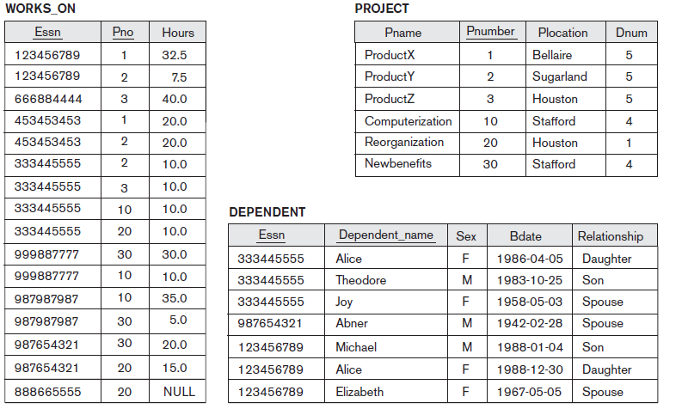
One possible database state for the COMPANY relational database schema.

Slide 95
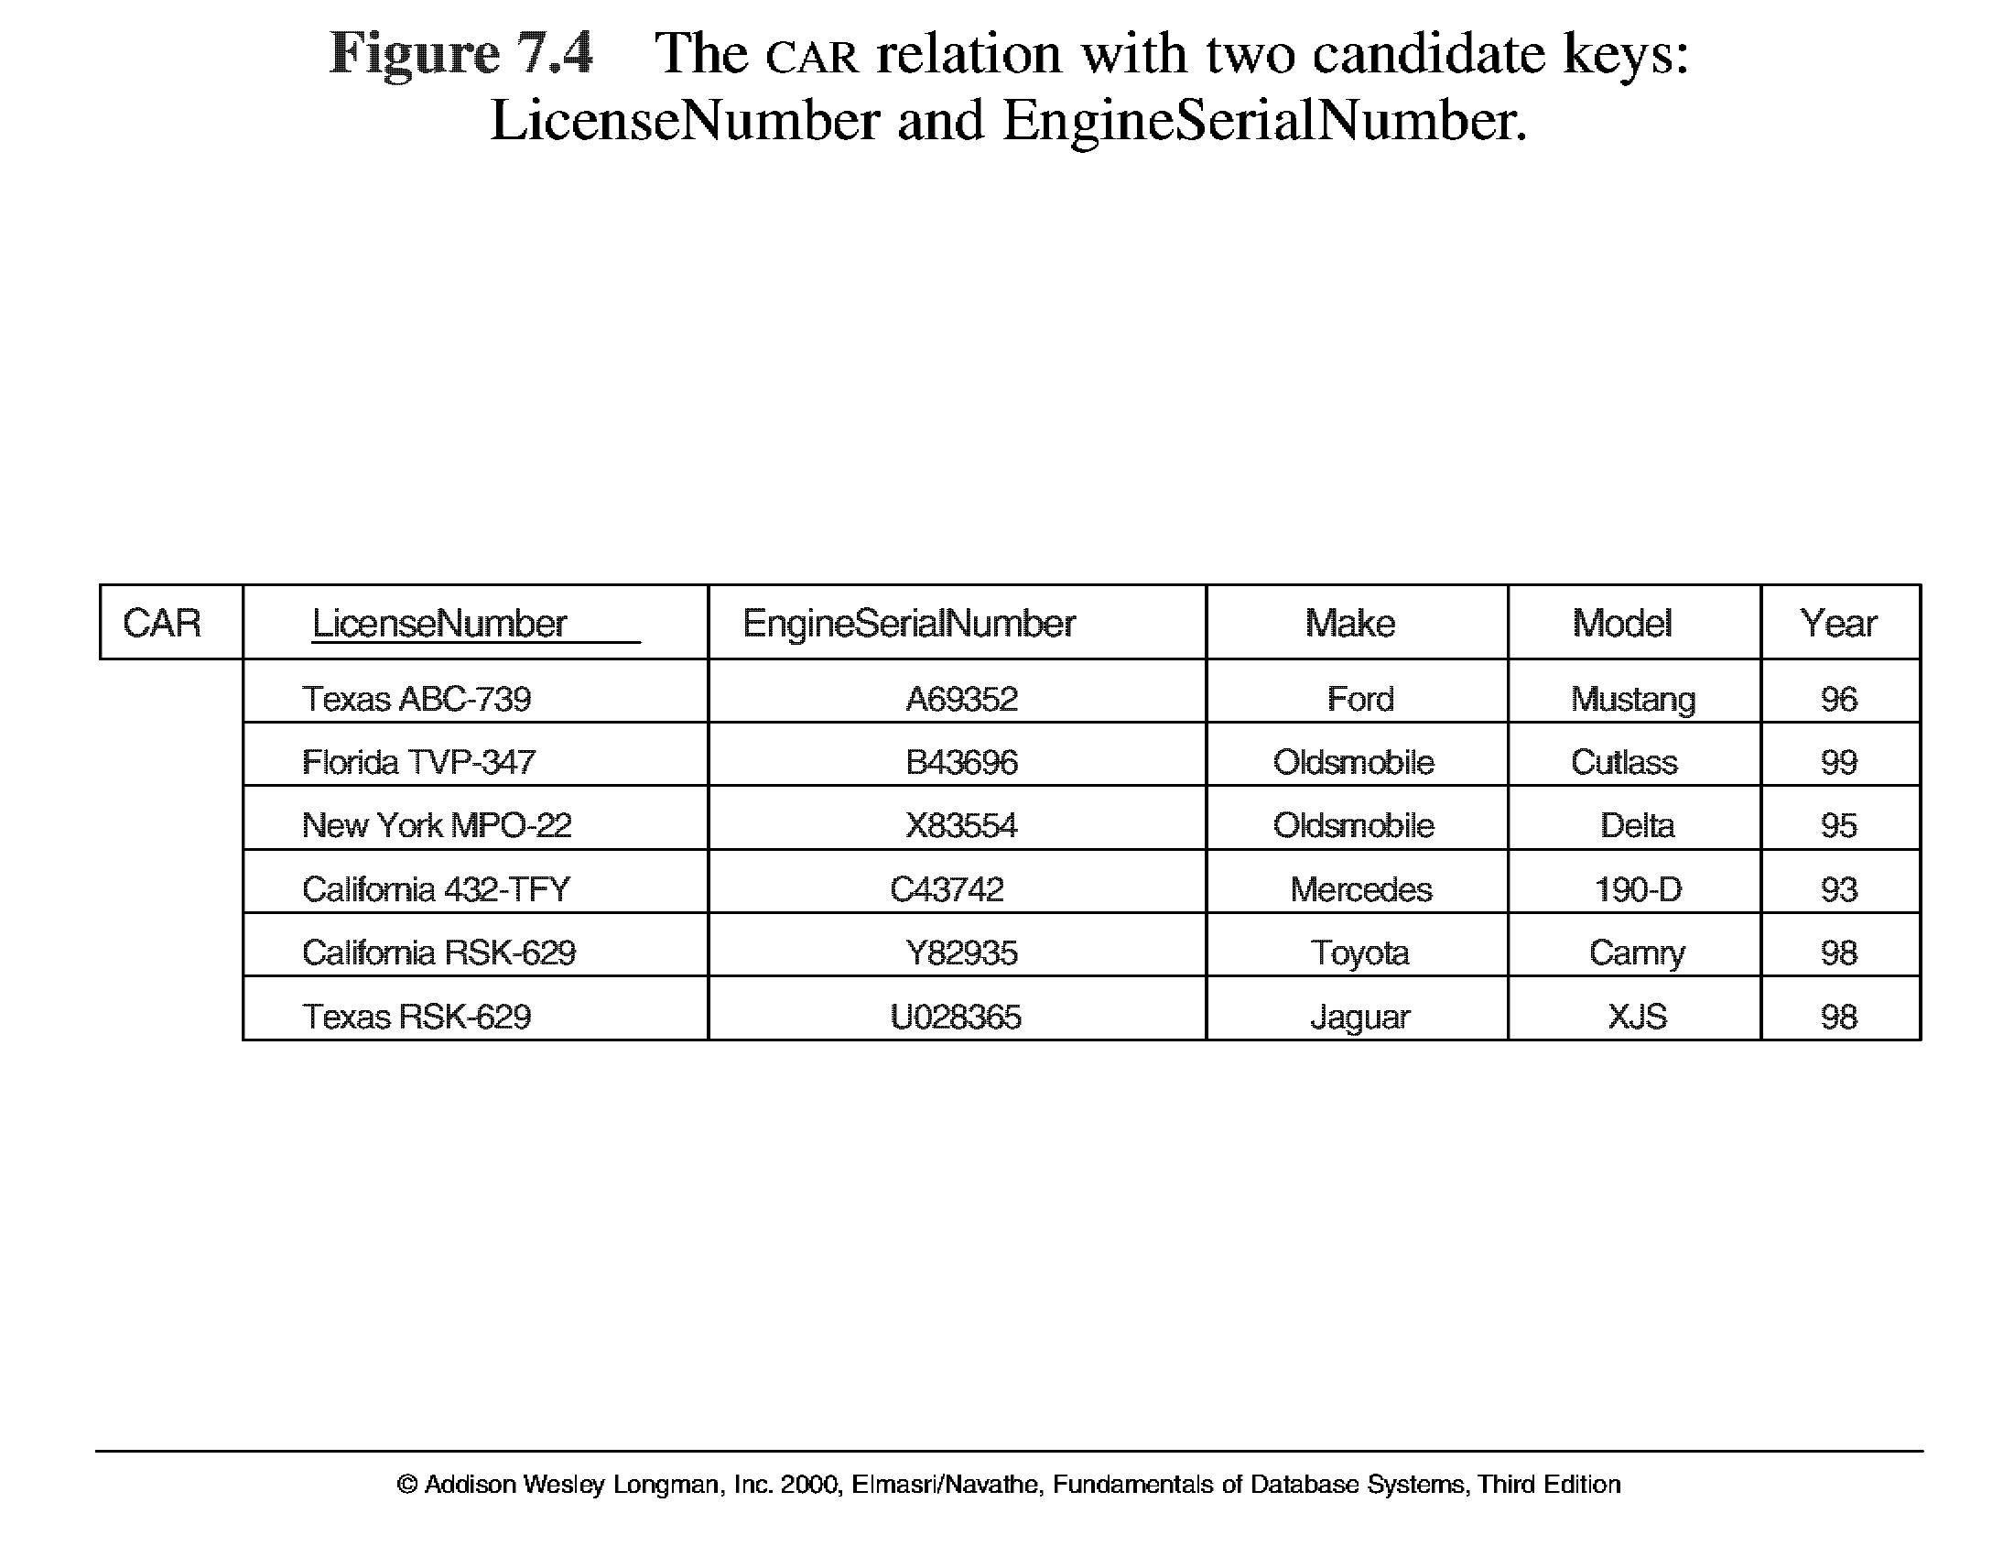
Key Constraints

Slide 96
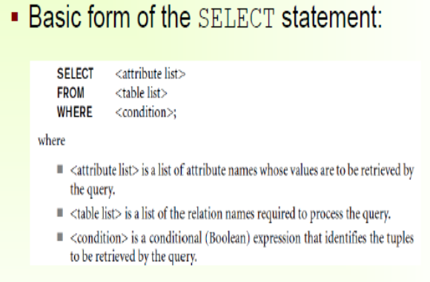
SELECT SQL

Slide 97
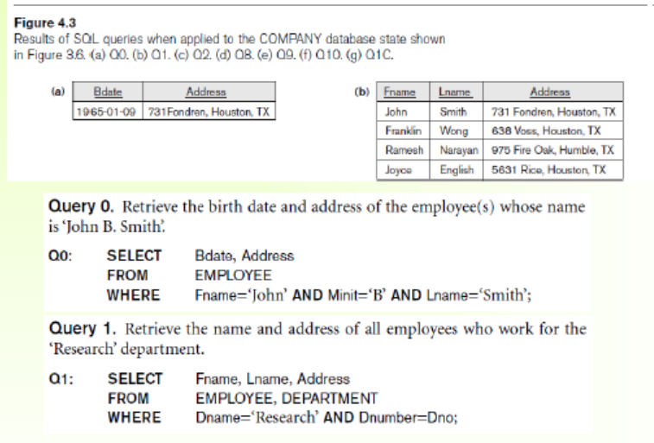
SELECT SQL

Slide 98
SELECT Example query
Query 1. Retrieve the name and address of all employees who work for the
‘Research’ department.
SELECT Fname, Lname, Address FROM EMPLOYEE, DEPARTMENT
WHERE Dname=‘Research’ AND Dnumber=Dno;

Slide 99
SELECT example query
Query 2. For every project located in ‘Stafford’, list the project number, the
controlling department number, and the department manager’s last name,
address, and birth date.
SELECT Pnumber, Dnum, Lname, Address, Bdate FROM PROJECT, DEPARTMENT, EMPLOYEE WHERE Dnum=Dnumber AND Mgr_ssn=Ssn AND Plocation=‘Stafford’;

Slide 100
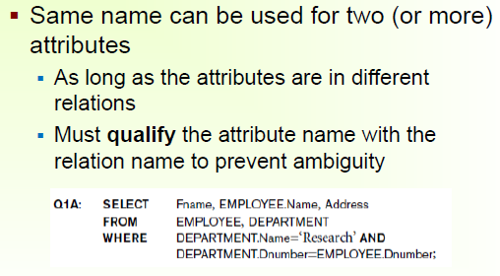
SELECT QUERY

Slide 101
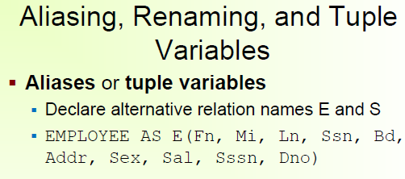
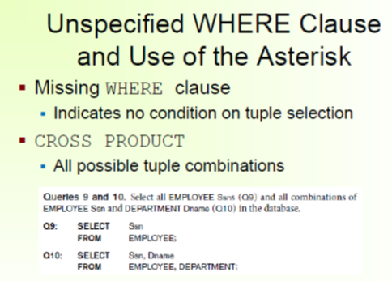
SELECT QUERY

Slide 102
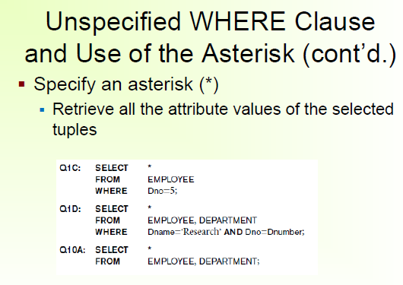
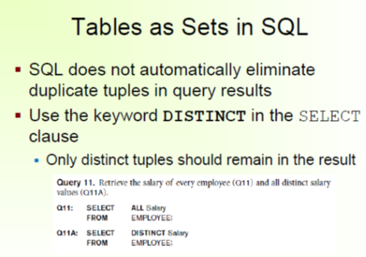
SELECT QUERY

Slide 103
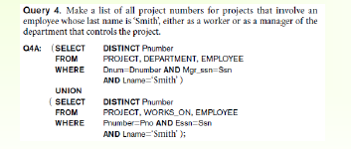
SELECT QUERY

Slide 104
SELECT QUERY

Slide 105
SELECT AND AGGREGATE FUNCTIONS
MIN returns the smallest value in a given column
MAX returns the largest value in a given column
SUM returns the sum of the numeric values in a given column
AVG returns the average value of a given column
COUNT returns the total number of values in a given column
COUNT(*) returns the number of rows in a table

Slide 106
SELECT AND AGGREGATE FUNCTIONS
Aggregate functions are used to compute against a "returned column of numeric data" from your SELECT statement. They basically summarize the results of a particular column of selected data. We are covering these here since they are required by the next topic, "GROUP BY". Although they are required for the "GROUP BY" clause, these functions can be used without the "GROUP BY" clause. For example:
SELECT AVG(salary) FROM employee;
This statement will return a single result which contains the average value of everything returned in the
salary column from the employee table.
Another example:
SELECT AVG(salary) FROM employee WHERE title = 'Programmer';
This statement will return the average salary for all employee whose title is equal to 'Programmer'
Example:
SELECT Count(*) FROM employee;
This particular statement is slightly different from the other aggregate functions since there isn't a column
supplied to the count function. This statement will return the number of rows in the employees table

Slide 107
SELECT AND AGGREGATE FUNCTIONS
Items_order :
Customerid | Order_date | item | quantity | price
Customers
Customerid | firstname | lastname | city | state
Review Exercises
Select the maximum price of any item ordered in the items_ordered table. Hint: Select the maximum price only.
Select the average price of all of the items ordered that were purchased in the month of Dec.
What are the total number of rows in the items_ordered table?
For all of the tents that were ordered in the items_ordered table, what is the price of the lowest tent? Hint: Your query should return the price only.

Slide 108
Aggregate Function Exercise Answers
Exercise #1
SELECT max(price) FROM items_ordered;
Exercise #2
SELECT avg(price) FROM items_ordered WHERE order_date LIKE '%Dec%';
Exercise #3
SELECT count(*) FROM items_ordered;
Exercise #4
SELECT min(price) FROM items_ordered WHERE item = 'Tent';

Slide 109
GROUP BY clause
The GROUP BY clause will gather all of the rows together that contain data in the specified column(s)
and will allow aggregate functions to be performed on the one or more columns. This can best be explained
by an example: GROUP BY clause syntax:
SELECT column1, SUM(column2) FROM "list-of-tables“ GROUP BY "column-list";
Let's say you would like to retrieve a list of the highest paid salaries in each dept:
SELECT max(salary), dept FROM employee GROUP BY dept;
This statement will select the maximum salary for the people in each unique department. Basically, the salary for the person who makes the most in each department will be displayed. Their, salary and their department will be returned.

Slide 110
GROUPBY examples
For example, take a look at the items_ordered table. Let's say you want to group everything of quantity 1 together, everything of quantity 2 together, everything of quantity 3 together, etc. If you would like to determine what the largest cost item is for each grouped quantity (all quantity 1's, all quantity 2's, all quantity 3's, etc.), you would enter:
SELECT quantity, max(price) FROM items_ordered GROUP BY quantity;
Enter the statement in above, and take a look at the results to see if it returned what you were expecting. Verify that the maximum price in each Quantity Group is really the maximum price.

Slide 111
Exercise
How many people are in each unique state in the customers table? Select the state and display the number of people in each. Hint: count is used to count rows in a column, sum works on numeric data only.
From the items_ordered table, select the item, maximum price, and minimum price for each specific item in the table. Hint: The items will need to be broken up into separate groups.
3. How many orders did each customer make? Use the items_ordered table. Select the customerid, number of orders they made, and the sum of their orders. Click the Group By answers link below if you have any problems.

Slide 112
Answers
Exercise #1
SELECT state, count(state) FROM customers GROUP BY state;
Exercise #2
SELECT item, max(price), min(price) FROM items_ordered GROUP BY item;
Exercise #3
SELECT customerid, count(customerid), sum(price) FROM items_ordered GROUP BY customerid;

Slide 113
JOINS
Join is a binary operation which allows you to combine join product and selection in one single statement. The goal of creating a join condition is that it helps you to combine the data from multiple join tables.
SQL Joins allows you to retrieve data from two or more DBMS tables. The tables in DBMS are associated using the primary key and foreign keys.
Types of Join
There are mainly two types of joins in DBMS:
Inner Joins
Outer Join

Slide 114
JOINS
An inner join is the widely used join operation and can be considered as a default join-type. The inner JOIN is used to return rows from both tables which satisfy the given condition.
An Inner join or equijoin is a comparator-based join which uses equality comparisons in the join-predicate. However, if you use other comparison operators like ">" can't be called equijoin.
Inner Join further divided into three subtypes:
Theta join
Natural join
EQUI join

Slide 115
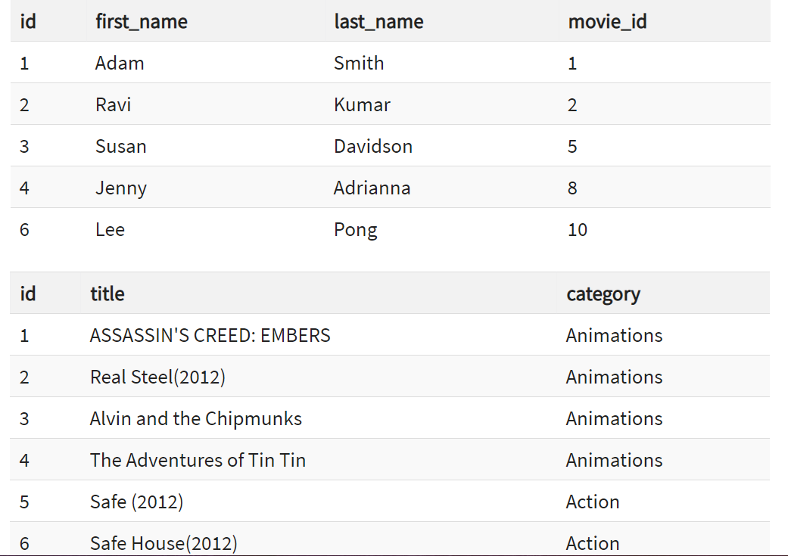
JOINS : INNER, OUTER, LEFT, RIGHT, CROSS

Slide 116
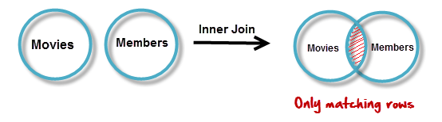
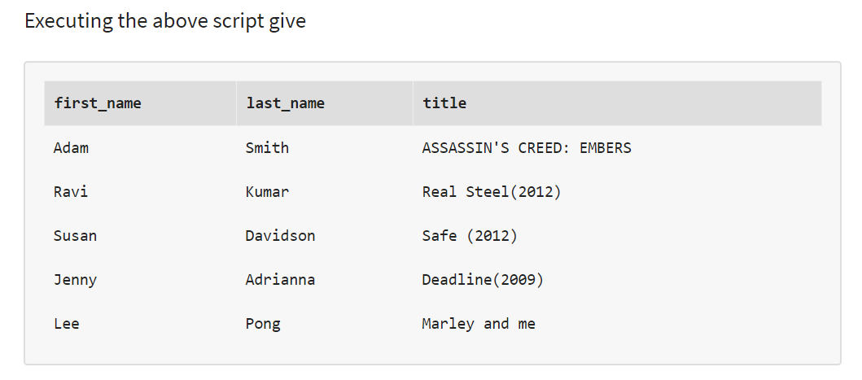
INNER JOINS
The inner JOIN is used to return rows from both tables that satisfy the given condition.
Suppose , you want to get list of members who have rented movies together with titles of movies rented by them. You can simply use an INNER JOIN for that, which returns rows from both tables that satisfy with given conditions.
SELECT members.`first_name` , members.`last_name` , movies.`title` FROM members ,movies WHERE movies.`id` = members.`movie_id`
SELECT A.`first_name` , A.`last_name` , B.`title` FROM `members`AS A INNER
JOIN `movies` AS B ON B.`id` = A.`movie_id`
above results script can also be written as follows to achieve the same results.

Slide 117
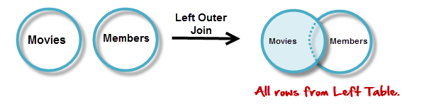
Outer JOINs
Outer JOINs return all records matching from both tables .
It can detect records having no match in joined table. It returns NULL values for records of joined table if no match is found.
LEFT JOIN
Assume now you want to get titles of all movies together with names of members who have rented them. It is clear that some movies have not being rented by any one. We can simply use LEFT JOIN for the purpose.
The LEFT JOIN returns all the rows from the table on the left even if no matching rows have been found in the table on the right. Where no matches have been found in the table on the right, NULL is returned.
SELECT A.`title` , B.`first_name` , B.`last_name`
FROM `movies` AS A
LEFT JOIN `members` AS B
ON B.`movie_id` = A.`id`

Slide 118
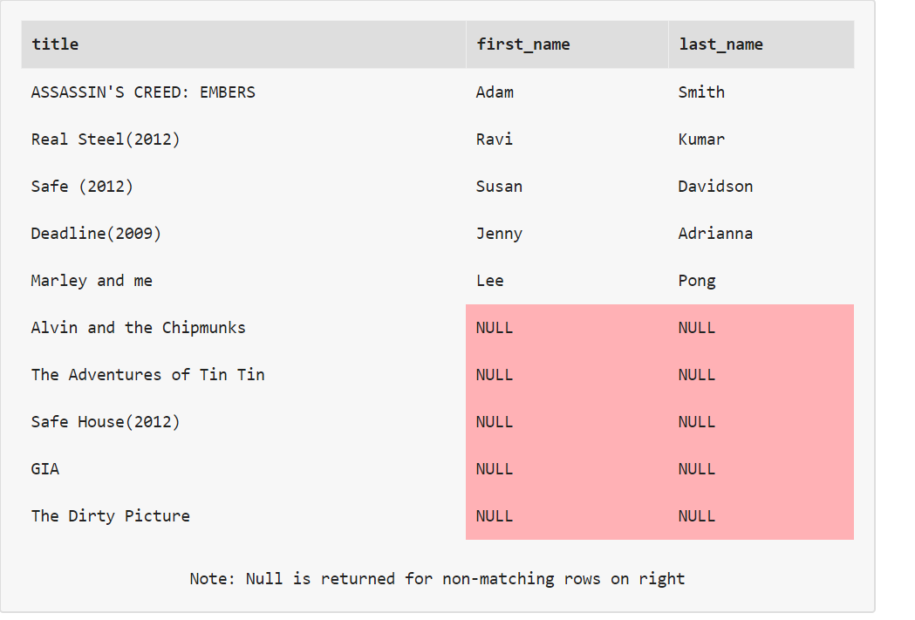
LEFT JOIN
SELECT A.`title` , B.`first_name` , B.`last_name`
FROM `movies` AS A
LEFT JOIN `members` AS B
ON B.`movie_id` = A.`id`
WHY SOME NULL?
we can see that in the returned result which is listed below that for movies which are not rented, member name fields are having NULL values. That means no matching member found members table for that particular movie.

Slide 119
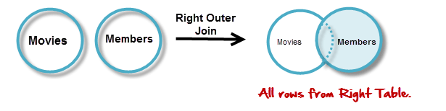
RIGHT JOIN
RIGHT JOIN is obviously the opposite of LEFT JOIN. The RIGHT JOIN returns all the columns from the table on the right even if no matching rows have been found in the table on the left. Where no matches have been found in the table on the left, NULL is returned.
In our example, let's assume that you need to get names of members and movies rented by them. Now we have a new member who has not rented any movie yet

Slide 120
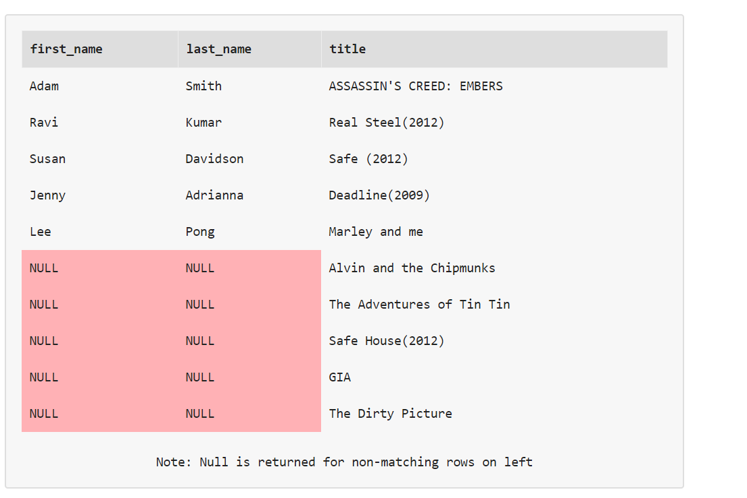
RIGHT JOIN
SELECT A.`first_name` , A.`last_name`, B.`title`
FROM `members` AS A
RIGHT JOIN `movies` AS B
ON B.`id` = A.`movie_id`

Slide 121
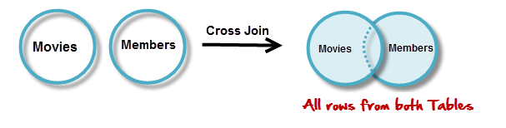
Cross JOIN in MySQL
Cross JOIN is a simplest form of JOINs which matches each row from one database table to all rows of another.
In other words it gives us combinations of each row of first table with all records in second table.
Suppose we want to get all member records against all the movie records, we can use the script shown below to get our desired results.
SELECT * FROM `movies` CROSS JOIN `members`

Slide 122
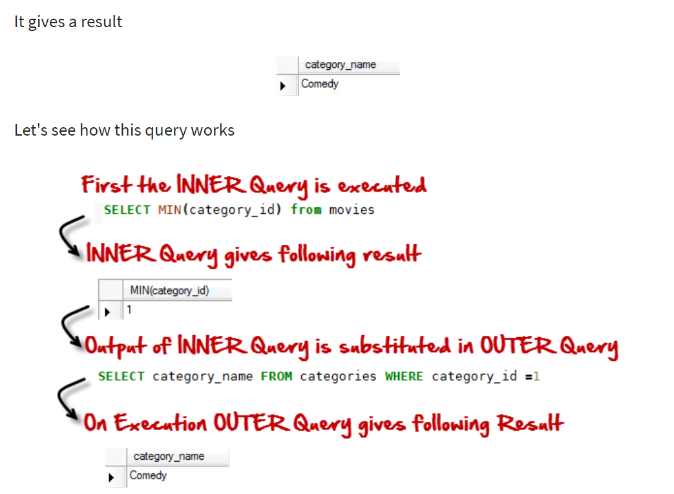
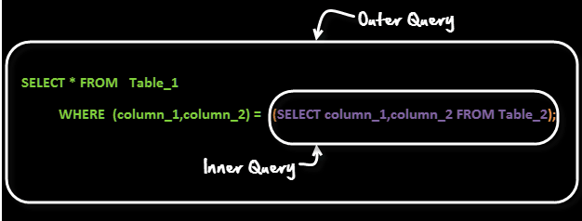
SUBQUERY inner query with one result
Case Study:
A common customer complaint at the MyFlix Video Library is the low number of movie titles. The management wants to buy movies for a category which has least number of titles.
SELECT category_name FROM categories WHERE category_id =( SELECT MIN(category_id) from movies);

Slide 123
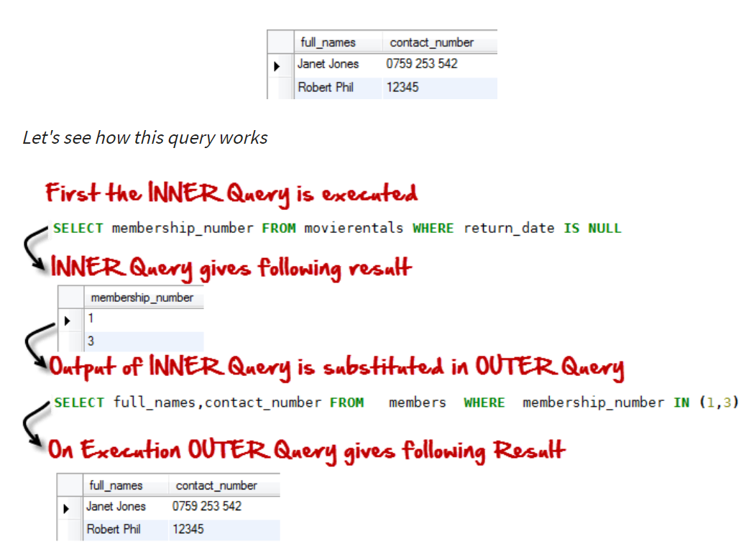
SUBQUERY inner query with more than one result
Suppose you want Names and Phone numbers of members of people who have rented a movie and are yet to return them. Once you get Names and Phone Number you call them up to give a reminder. You can use a query like
SELECT full_names,contact_number FROM members WHERE membership_number IN (SELECT membership_number FROM movierentals WHERE return_date IS NULL );

Slide 124
SUBQUERY
Row Sub-Query. In such sub-queries the , inner query can give only ONE result. The permissible operators when work with row subqueries are [=, >, =, <=, ,!=, ]
When the inner query returns more than one results. Then called Table sub-query.

Slide 125

SUBQUERY
Till now we have seen two queries , lets now see an example of triple query!!!
Suppose the management wants to reward the highest paying member.
We can run a query like
Select full_names From members WHERE membership_number = (SELECT membership_number FROM payments WHERE amount_paid = (SELECT MAX(amount_paid) FROM payments));

Slide 126
SUBQUERIES
Subqueries are embedded queries inside another query. The embedded query is known as the inner query and the container query is known as the outer query.
Sub queries are easy to use, offer great flexibility and can be easily broken down into single logical components making up the query which is very useful when Testing and debugging the queries.
MySQL supports three types of subqueries, scalar, row and table subqueries.
Scalar sub queries only return a single row and single column.
Row sub queries only return a single row but can have more than one column.
Table subqueries can return multiple rows as well as columns.
Subqueries can also be used in INSERT, UPDATE and DELETE queries.
For performance issues, when it comes to getting data from multiple tables, it is strongly recommended to use JOINs instead of subqueries. Sub queries should only be used with good reason.

Slide 127

SUBQUERY and JOINS
Sub-Queries Vs Joins!
When compare with Joins , sub-queries are simple to use and easy to read. They are not as complicated as Joins
Hence there are frequently used by SQL beginners.
But sub-queries have performance issues. Using a join instead of a sub-query can at times give you upto 500 times performance boost.
Given a choice, it is recommended to use a JOIN over a sub query.
Sub-Queries should only be used as a fallback solution when you cannot use a JOIN operation to achieve the above

Slide 128
VIEWS
A view is a virtual table.
This chapter shows how to create, update, and delete a view.
In SQL, a view is a virtual table based on the result-set of an SQL statement.
A view contains rows and columns, just like a real table. The fields in a view are fields from one or more real tables in the database.
You can add SQL functions, WHERE, and JOIN statements to a view and present the data as if the data were coming from one single table.
Syntax
CREATE VIEW view_name AS SELECT column_name(s) FROM table_name WHERE condition
Note: A view always shows up-to-date data! The database engine recreates the data, using the view's SQL statement, every time a user queries a view.

Slide 129
VIEWS
a)The view "Current Product List" lists all active products (products that are not discontinued) from the "Products" table. The view is created with the following SQL:
CREATE VIEW [Current Product List] AS SELECT ProductID,ProductName FROM Products WHERE Discontinued=No
We can query the view above as follows:
SELECT * FROM [Current Product List]
b)
selects every product in the "Products" table with a unit price higher than the average unit price:
CREATE VIEW [Products Above Average Price] AS SELECT ProductName,UnitPrice FROM Products WHERE UnitPrice>(SELECT AVG(UnitPrice) FROM Products)
We can query the view above as follows:
SELECT * FROM [Products Above Average Price]

Slide 130
VIEWS
c)calculates the total sale for each category in 1997. Note that this view selects its data from another view called "Product Sales for 1997":
CREATE VIEW [Category Sales For 1997] AS SELECT DISTINCT CategoryName,Sum(ProductSales) AS CategorySales FROM [Product Sales for 1997] GROUP BY CategoryName
We can query the view above as follows:
SELECT * FROM [Category Sales For 1997]
To add a condition to the query. Now we want to see the total sale only for the category "Beverages":
SELECT * FROM [Category Sales For 1997] WHERE CategoryName='Beverages'
d)update a view by using the following syntax:
Syntax
CREATE OR REPLACE VIEW view_name AS SELECT column_name(s) FROM table_name WHERE condition
To add the "Category" column to the "Current Product List" view. We will update the view with the following SQL:
CREATE OR REPLACE VIEW [Current Product List] AS SELECT ProductID,ProductName,Category FROM Products WHERE Discontinued=No
e)To delete a view with the DROP VIEW command.
Syntax is:
DROP VIEW view_name
Can view have CRUD operations?

Slide 131
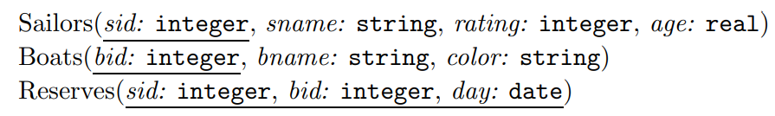
SQL tutorials
Find the names and ages of all sailors.
SELECT DISTINCT S.sname, S.age FROM Sailors S
Find all sailors with a rating above 7.
SELECT S.sid, S.sname, S.rating, S.age FROM Sailors AS S WHERE S.rating > 7
Find the names of sailors who have reserved boat number 103.
SELECT S.sname FROM Sailors S, Reserves R WHERE S.sid = R.sid AND R.bid=103
Find the sids of sailors who have reserved a red boat.
SELECT R.sid FROM Boats B, Reserves R WHERE B.bid = R.bid AND B.color = ‘red’

Slide 132
SQL tutorials
Find the names of sailors who have reserved a red boat.
SELECT S.sname FROM Sailors S, Reserves R, Boats B WHERE S.sid = R.sid AND R.bid = B.bid AND B.color = ‘red’
Find all sailors with a rating less than 20.
SELECT S.sid, S.sname, S.rating, S.age FROM Sailors AS S WHERE S.rating <20
Find the colors of boats reserved by Lubber.
SELECT B.color FROM Sailors S, Reserves R, Boats B WHERE S.sid = R.sid AND R.bid = B.bid AND S.sname = ‘Lubber’
Find the names of sailors who have reserved at least one boat.
SELECT S.sname FROM Sailors S, Reserves R WHERE S.sid = R.sid

Slide 133
SQL tutorials
Compute increments for the ratings of persons who have sailed two different boats on the same day.
SELECT S.sname, S.rating+1 AS rating FROM Sailors S, Reserves R1, Reserves R2 WHERE S.sid = R1.sid AND S.sid = R2.sid AND R1.day = R2.day AND R1.bid <> R2.bid
Find the ages of sailors whose name begins and ends with B and has at least three characters.
SELECT S.age FROM Sailors S WHERE S.sname LIKE ‘B %B’
Find the names of sailors who have reserved both a red and a green boat.
SELECT S.sname FROM Sailors S, Reserves R1, Boats B1, Reserves R2, Boats B2 WHERE S.sid = R1.sid AND R1.bid = B1.bid AND S.sid = R2.sid AND R2.bid = B2.bid AND B1.color=‘red’ AND B2.color = ‘green’
Or
SELECT S.sname FROM Sailors S, Reserves R, Boats B WHERE S.sid = R.sid AND R.bid = B.bid AND B.color = ‘red’
UNION
SELECT S2.sname FROM Sailors S2, Boats B2, Reserves R2 WHERE S2.sid = R2.sid AND R2.bid = B2.bid AND B2.color = ‘green’

Slide 134
SQL tutorials
Find the sids of all sailors who have reserved red boats but not green boats.
SELECT S.sid FROM Sailors S, Reserves R, Boats B WHERE S.sid = R.sid AND R.bid = B.bid AND B.color = ‘red’
EXCEPT
SELECT S2.sid FROM Sailors S2, Reserves R2, Boats B2 WHERE S2.sid = R2.sid AND R2.bid = B2.bid AND B2.color = ‘green’
EXCEPT clause/operator is used to combine two SELECT statements and returns rows from the first SELECT statement that are not returned by the second SELECT statement. Similar to minus in relational algebraic operator.

Slide 135
SQL tutorials
Find all sids of sailors who have a rating of 10 or have reserved boat 104.
SELECT S.sid FROM Sailors S WHERE S.rating = 10 UNION SELECT R.sid FROM Reserves R WHERE R.bid = 10
Find the names of sailors who have reserved boat 103.
SELECT S.sname FROM Sailors S WHERE S.sid IN ( SELECT R.sid FROM Reserves R WHERE R.bid = 103 )
Find the names of sailors who have reserved a red boat.
:
SELECT S.sname FROM Sailors S WHERE S.sid IN ( SELECT R.sid FROM Reserves R WHERE R.bid IN ( SELECT B.bid FROM Boats B WHERE B.color = ‘red’ )
Find the names of sailors who have not reserved a red boat.
SELECT S.sname FROM Sailors S WHERE S.sid NOT IN ( SELECT R.sid FROM Reserves R WHERE R.bid IN ( SELECT B.bid FROM Boats B WHERE B.color = ‘red’ )
To find the names of sailors who have not reserved a red boat, we replace the outermost occurrence of IN by NOT IN
Find the names of sailors who have reserved boat number 103. correlated ie., inner subquery could depend on the row that is currently being examined in the outer query
SELECT S.sname FROM Sailors S WHERE EXISTS ( SELECT * FROM Reserves R WHERE R.bid = 103 AND R.sid = S.sid )

Slide 136
SQL tutorials
Find sailors whose rating is better than some sailor called Horatio.
SELECT S.sid FROM Sailors S WHERE S.rating > ANY ( SELECT S2.rating FROM Sailors S2 WHERE S2.sname = ‘Horatio’ )
Find sailors whose rating is better than every sailor called Horatio.
SELECT S.sid FROM Sailors S WHERE S.rating > ALL ( SELECT S2.rating FROM Sailors S2 WHERE S2.sname = ‘Horatio’ )
Find the sailors with the highest rating.
Any other eqivalent SQL stmt?
SELECT S.sid FROM Sailors S WHERE S.rating >= ALL ( SELECT S2.rating FROM Sailors S2 )
Find the names of sailors who have reserved both a red and a green boat.
SELECT S.sname FROM Sailors S, Reserves R, Boats B WHERE S.sid = R.sid AND R.bid = B.bid AND B.color = ‘red’ AND S.sid IN ( SELECT S2.sid FROM Sailors S2, Boats B2, Reserves R2 WHERE S2.sid = R2.sid AND R2.bid = B2.bid AND B2.color = ‘green’ )
Or
SELECT S3.sname FROM Sailors S3 WHERE S3.sid IN (( SELECT R.sid FROM Boats B, Reserves R WHERE R.bid = B.bid AND B.color = ‘red’ ) INTERSECT (SELECTR2.sid FROM Boats B2, Reserves R2 WHERE R2.bid = B2.bid AND B2.color = ‘green’ ))

Slide 137
SQL tutorials
Find the names of sailors who have reserved all boats.
SELECT S.sname FROM Sailors S WHERE NOT EXISTS (( SELECT B.bid FROM Boats B ) EXCEPT (SELECTR.bid FROM Reserves R WHERE R.sid = S.sid ))
Or using division as using not exists
SELECT S.sname FROM Sailors S WHERE NOT EXISTS ( SELECT B.bid FROM Boats B WHERE NOT EXISTS ( SELECT R.bid FROM Reserves R WHERE R.bid = B.bid AND R.sid = S.sid ))
Find the average age of all sailors
SELECT AVG (S.age) FROM Sailors
Find the average age of sailors with a rating of 10.
SELECT AVG (S.age) FROM Sailors S WHERE S.rating = 10
Find the name and age of the oldest sailor.
SELECT S.sname, S.age FROM Sailors S WHERE S.age = ( SELECT MAX (S2.age) FROM Sailors S2 )
Count the number of sailors.
SELECT COUNT (*) FROM Sailors S
Count the number of different sailor names.
SELECT COUNT ( DISTINCT S.sname ) FROM Sailors S
Find the names of sailors who are older than the oldest sailor with a rating of 10.
SELECT S.sname FROM Sailors S WHERE S.age > ( SELECT MAX ( S2.age ) FROM Sailors S2 WHERE S2.rating = 10 )
Or
SELECT S.sname FROM Sailors S WHERE S.age > ALL ( SELECT S2.age FROM Sailors S2 WHERE S2.rating = 10 )

Slide 138
SQL tutorials
Find the age of the youngest sailor for each rating level
SELECT S.rating, MIN (S.age) FROM Sailors S GROUP BY S.rating
Find the age of the youngest sailor who is eligible to vote (i.e., is at least 18 years old) for each rating level with at least two such sailors.
SELECT S.rating, MIN (S.age) AS minage FROM Sailors S WHERE S.age >= 18 GROUP BY S.rating HAVING COUNT (*) > 1
For each red boat, find the number of reservations for this boat.
SELECT B.bid, COUNT (*) AS sailorcount FROM Boats B, Reserves R WHERE R.bid = B.bid GROUP BY B.bid HAVING B.color = ‘red’
Find the average age of sailors for each rating level that has at least two sailors.
SELECT S.rating, AVG (S.age) AS avgage FROM Sailors S GROUP BY S.rating HAVING COUNT (*) > 1
Or
SELECT S.rating, AVG ( S.age ) AS avgage FROM Sailors S GROUP BY S.rating HAVING 1 < ( SELECT COUNT (*) FROM Sailors S2 WHERE S.rating = S2.rating )

Slide 139
SQL tutorials
Find those ratings for which the average age of sailors is the minimum over all ratings.
SELECT Temp.rating, Temp.avgage FROM ( SELECT S.rating, AVG (S.age) AS avgage, FROM Sailors S GROUP BY S.rating) AS Temp
WHERE Temp.avgage = ( SELECT MIN (Temp.avgage) FROM Temp )
lists sid,bid pairs corresponding to sailors and boats they have reserved:
SELECT Sailors.sid, Reserves.bid FROM Sailors LEFT OUTER JOIN Reserves R
Find the average age of sailors who are of voting age (i.e., at least 18 years old) for each rating level that has at least two sailors
SELECT S.rating, AVG ( S.age ) AS avgage FROM Sailors S WHERE S. age >= 18 GROUP BY S.rating HAVING 1 < ( SELECT COUNT (*) FROM Sailors S2 WHERE S.rating = S2.rating )

Slide 140
THANK YOU

